Slide 1
Live-to-Digital in the Arts
Across music, dance, opera, visual arts, literature, combined arts and museums
Final Report
11 May 2018 │ MTM │ matthew.macaulay@mtmlondon.com │ Tel +44 (0) 203 7508 472

Slide 2
Executive summary
Objectives and method
What live-to-digital work is being created?
Who is the audience for live-to-digital, and what impact is it having on them?
The future – where next for live-to-digital?
Key take outs for arts organisations
What does this research add to the overall picture of live to digital in the arts in England?

Slide 3
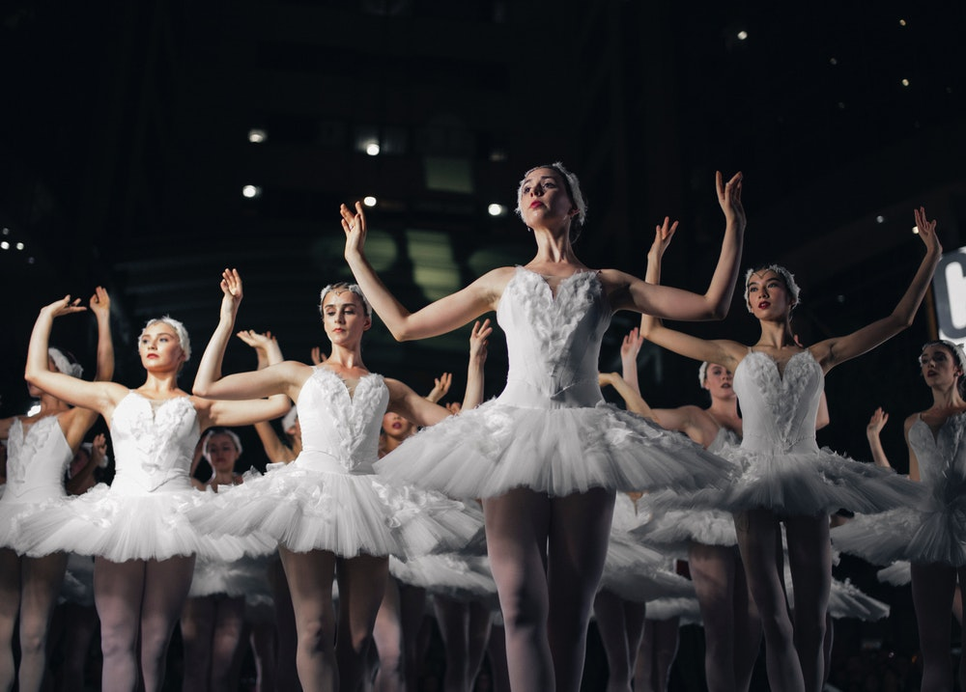
1. Executive summary

Slide 4
Executive summary
Executive summary
We define live-to-digital arts as a live performance, event or experience captured and distributed digitally, through television, cinema, or online. The content is recorded live but does not need to be distributed live.
The findings below relate to organisations and audiences in England covering opera, music, dance, combined arts, visual arts, museums and literature. Theatre is not included in this study as it was the subject of a previous report
What live-to-digital work is being created and how is it distributed?
Live-to-digital production is more developed in the performing arts than in the non-performing arts, including museums: 58% of the organisations we surveyed who had not produced live-to-digital were non-performing arts. Music, dance and opera organisations have a ready-made performance which naturally lends itself to video or audio capture, whereas museums, galleries and literature organisations have to work harder to translate their often static ‘real world’ offer into a dynamic live-to-digital experience.
Music, dance and opera organisations tend to engage in more regular and large-scale live-to-digital output than the non-performing arts: large-scale live-to-digital is well established for the bigger opera, dance and music organisations e.g. The Royal Opera House and Glyndebourne, who use a variety of channels including cinema, TV and online to distribute complete dance and opera performances. In the commercial music realm live-to-digital is widespread with the major festivals regularly live-streaming performances online.
Just over a quarter of organisations surveyed claim live-to-digital is a core part of their output: 6% said ‘everything we do has a live-to-digital element to some degree’ and a further 20% said ‘we incorporate live-to-digital into the majority of our work’. Of the organisations surveyed who undertook live-to-digital in 2016/17, the vast majority are producing video forms of the medium (93%), though a small percentage are experimenting with 360-degree video (10%) and virtual and augmented reality (5% and 3% respectively).
Online is by far the most common method of distribution, followed by showings in physical venues and then TV: 96% of the organisations surveyed who undertook live-to-digital in 2016/17 used online platforms to distribute.
Easy to use online platforms like Facebook and YouTube offer a low-risk, low-cost means of arts organisations undertaking live-to-digital: the launch of YouTube, YouTube Live and then Facebook Live all coincided with an uplift in live-to-digital production. These accessible platforms combined with relatively inexpensive recording technology is allowing museums and galleries as well as performing arts companies to engage in live-to-digital, through exhibition tours and events.

Slide 5
Executive summary
Executive summary
Why are organisations creating live-to-digital and how successful has it been?
The key reasons for producing live-to-digital is to reach a larger and more diverse audience: 37% of the organisations surveyed who undertook live-to-digital in 2016/17 say reaching a larger audience is the main reason for creating live-to-digital. Second to this is reaching a more diverse audience to that which might consume the organisation’s ‘real-world’ offer: 10% of organisations say this is their main reason for undertaking live-to-digital. Organisations view live-to-digital as having the potential to serve audiences who would otherwise be excluded from their work because of location (67% want to reach national audiences; 61% want to reach international audiences) or cost (19%). Other motivations for undertaking live-to-digital include boosting the organisation’s public profile and building brand (70% and 58%).
Only a small percentage of arts organisations view live-to-digital as a means of revenue generation: 93% of organisations surveyed who undertook live-to-digital in 2016/17 do not cite revenue generation as a reason to create live-to-digital and only 9% say live-to-digital contributes to their financial stability, though just over a quarter expect it to do so in the future.
Organisations see live-to-digital as complementary to rather than cannibalising their ‘real world’ offer: no organisations surveyed who undertook live-to-digital in 2016/17 perceived live-to-digital to result in their audiences attending fewer ‘real-world’ performances and events and 26% said they believed their audiences attend more ‘real-world’ performances and events as a result of their live-to-digital output.
There is strong appetite amongst organisations to create live-to-digital: almost all organisations surveyed who produced live-to-digital in 2016/17 said they would like to continue doing it and 99% of organisations view live-to-digital as having been a positive experience. 83% of organisations surveyed who did not produce live-to-digital in 2016/17 say they would be interested in doing so in the future.

Slide 6
Executive summary
Executive summary
How has live-to-digital affected touring patterns or programming decisions?
Live-to-digital has no adverse impact on touring and some influence on programming decisions: the majority of touring organisations surveyed felt live-to-digital had no impact on touring and none said it caused a decrease in touring: 11% said touring had increased as a result of live-to-digital, 83% said it had no impact at all and 0% said touring had decreased. Over half of those surveyed who produced live-to-digital in 2016/17 say it has had at least some influence on programming decisions. One of the main impacts on programming was that work selected for live-to-digital transmission is often that which the organisation thinks will appeal to a broad audience.

Slide 7
Executive summary
Executive summary
What are the key barriers to creating live-to-digital and how have they been overcome?
Cost and lack of staff time are significant barriers to producing live-to-digital amongst many organisations: 49% of organisations surveyed who produced live-to-digital in 2016/17 said lack of funds/cost was a significant barrier to creating live-to-digital and 47% said lack of staff time was. When it comes to organisations who did not create live-to-digital in 2016/17, 68% said cost was a significant barrier and 49% said lack of staff time.
Organisations who engage in live-to-digital tend to partner with other organisations to overcome barriers: two thirds of those surveyed who undertook live-to-digital in 2016/17 have worked with partners (primarily producers, followed by venues) to produce live-to-digital content. They cite reaching new audiences, followed by skills and equipment as the key reasons for doing so.
Greater understanding of live-to-digital and its benefits increases the propensity for organisations to undertake it: three of the top four factors which would increase likelihood of live-to digital production are connected to better understanding of the practicalities, benefits and opportunities involved.
Aside from funding, organisations said they would value more information on the opportunities for live-to-digital as well as increased collaboration and training: for organisations surveyed who did not produce live-to-digital in 2016/17 the most important factors that would encourage them to partake in live-to-digital (after funding) were, information and guidance on the opportunities that exist within their artform, increased collaboration between organisations, information about the benefits live-to-digital can bring to their organisation specifically and targeted training in video/audio production.

Slide 8
Executive summary
Executive summary
The findings below are from a nationally representative survey of the UK population and four discussion groups conducted with arts-engaged live-to-digital consumers
Who is consuming live-to-digital and what are they consuming?
Those consuming ‘real world’ arts and culture are demographically similar to those consuming live-to-digital: the demographic profile, including gender, age, local environment and social grade of those consuming ‘real world’ arts and culture is very similar to that of live-to-digital consumers.
Live-to-digital is consumed more than ‘real-world’ arts and culture: 33% of national survey respondents engage with live arts and culture once a month, while 46% claim to engage with live-to-digital work at least once a month. A fifth of adults claim to use live-to-digital monthly despite not attending any ‘real-world’ arts and cultural events.
Live-to-digital has considerable potential to introduce audiences to art forms and organisations they wouldn’t engage with otherwise: 56% of respondents to our national survey who consume live-to-digital have engaged with new artforms or with organisations that they wouldn’t have otherwise through their live-to-digital consumption.
Convenience and access are the most common motivations for consuming live-to-digital: the most common reason for consuming live-to-digital amongst our national sample is that it allows you to engage with content at a time and place that suits you. A close second to this, is that it broadens access, allowing audiences unable to attend because of time, geography, price or ticket limitations to experience a version of the ‘real-world’ performance or event. By comparison, our arts engaged sample cited the real-world event being too far away, or not being able to make it to the real-world event or experience as the most common reasons for consuming live-to-digital.
Music is the most popular form of live-to-digital content and music, live literature and opera are more commonly consumed in live-to-digital form than ‘real-world’ form: 52% of national survey respondents said they engage with music in a live-to-digital form every six months and 35% said they did so on a monthly basis.
People engage more with shorter live-to-digital content, but long form live-to-digital is also popular with some: 22% of national survey respondents who consume live-to-digital engage with content less than 5 minutes in length on a weekly basis, whereas 15% engage with content of between one and four hours in length on a monthly basis. The prevalence of short-form live-to-digital consumption is likely linked to the fact that Facebook and YouTube are two of the key channels where respondents come across live-to-digital. The discussion groups with live-to-digital audiences highlighted considerable passive consumption of live-to-digital, with people encountering performances or events through friends’ posts on Facebook or algorithmic recommendations on YouTube.

Slide 9
Executive summary
Executive summary
How does the live-to-digital experience compare to the ‘real world’ one?
Live-to-digital is thought of as a valuable replication of the real-world experience, but not a replacement: 57% of respondents to our nationally representative survey who consume live-to-digital agree that live-to-digital is a valuable replication of the ‘real world’ experience but will never compete with it and only 8% disagree.
What role will live-to-digital have for arts organisations and audiences in the future?
A substantial majority of those who did not produce live-to-digital in 2016/17 would be interested to do so in the future: 83% of organisations surveyed who did not produce live-to-digital in 2016/17 would like to produce it in the future.
Across all live-to-digital formats, there is an appetite for producing more rather than less in the coming years: the format most organisations who produced live-to-digital in 2016/17 expected to do more of was events and talks associated with artworks performances or exhibitions.
There is clear appetite amongst organisations to engage in VR, AR and 360-degree video: 50% of organisations surveyed who had not undertaken live-to-digital in 2016/17 would like to produce 360 degree video, 38% virtual reality and 38% augmented reality. Expert interviewees saw VR and AR as facilitating a more immersive and involving live-to-digital experience.
Expert interviewees identified a number of additional live-to-digital growth areas: interviewees felt live-to-digital could result in more interactive artworks using social media; increased incorporation of the medium into artistic practice; more partnerships between organisations of different types; and making historical sites and museum collections more accessible for educational purposes.
VR was seen by audiences as creating a more immersive but potentially isolating live-to-digital experience: participants in our discussion groups frequently mentioned the potential of virtual reality to create a more immersive live-to-digital experience but they expressed concern that VR, with its individual headsets, might lead to solitary experiences.
There is a clear desire amongst potential and current consumers to engage in live-to-digital in the future: amongst the respondents to our nationally representative survey, 41% anticipated engaging with live-to-digital on at least a monthly basis.

Slide 10
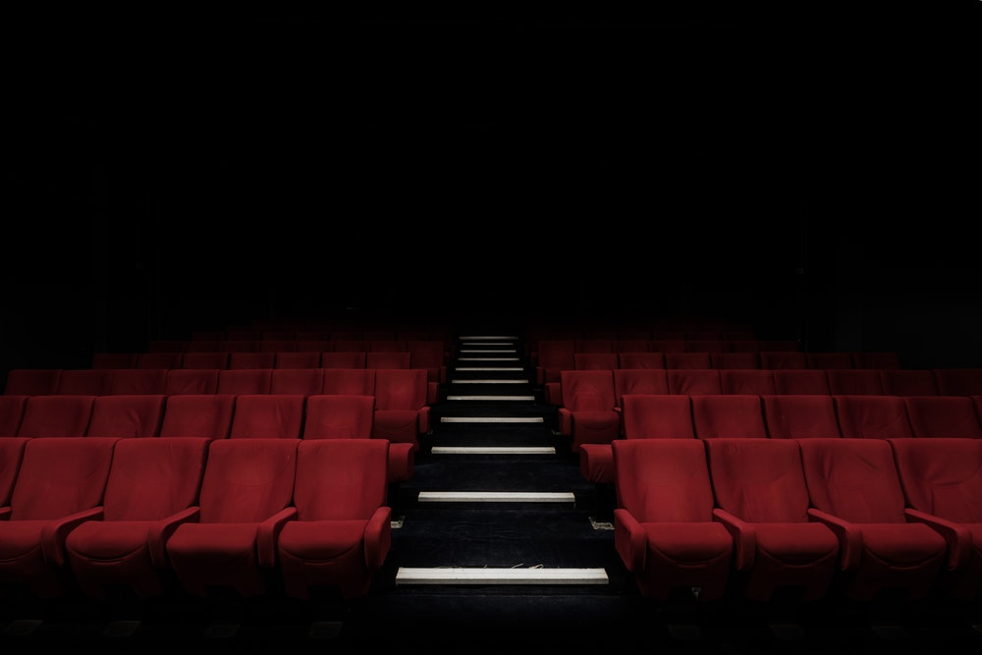
2. Objectives and method

Slide 11
Arts Council commissioned MTM to look at the impact of live-to-digital on audiences and arts organisations
Objectives & method
Research context:
Live-to-digital - a live performance, event or experience, captured and distributed digitally, through television, online, cinemas or other venues - has risen rapidly to prominence within the arts and the broader entertainment sector over the last decade. In 2016 Arts Council England commissioned AEA Consulting to assess the impact of live-to-digital on theatre. That study reported a gap in evidence about the impact of live-to-digital on other artforms
In 2017 MTM was commissioned to explore the effects of live-to-digital work on audiences and on arts and cultural organisations for artforms and cultural activity not covered by the theatre study: opera, music, dance, combined arts, visual arts, museums and literature
Research Questions:
To establish:
Who is engaging with live-to-digital, what are they engaging with and what motivates them?
How does the ‘real-world’ arts experience compare to the live-to-digital one?
What impact is live-to-digital having on audiences for ‘real-world’ performances and events?
What is the future propensity for audiences to consume live-to-digital?
What organisations are supplying live-to-digital work and what does it look like?
Through which channels are arts organisations distributing their live-to-digital work?
What are the motivations, opportunities and barriers for arts and cultural organisations to engage in live to digital?
Have touring patterns and/or programming decisions been affected by live-to-digital?
What are the opportunities and barriers for smaller arts and cultural organisations to create live to digital content, and for arts and cultural organisation in different regions of England?
What are the opportunities for arts organisations to partner with each other to create live-to-digital?

Slide 12
A multi-method research approach was followed
Objectives & method
1
Expert interviews
What? 21 telephone interviews with a range of arts and culture organisations across art forms
Why? to gain in depth insights into the live-to-digital practice of a number of key organisations across the artforms
2
Supply-side survey
What? Online survey of over 200 arts and culture organisations, sampled from the Digital Culture Survey participant set
Why? To gather quantitative measures from a broad range of arts organisations working across disciplines outside of theatre
3
Audience focus groups
What? 4 x 2-hour discussion groups (2 in Brighton and 2 in Sheffield) with an arts engaged live-to-digital audience
Why? To gain a clear understanding of views, expectations and experiences of live-to-digital amongst an arts engaged audience
4
Audience surveys
What? 2 x online surveys amongst consumers: 1 with a nationally representative sample, and 1 with an arts engaged audience
Why? To validate qualitative findings, and help to scale findings up to the wider population
For further detail about our approach see the Appendix

Slide 13
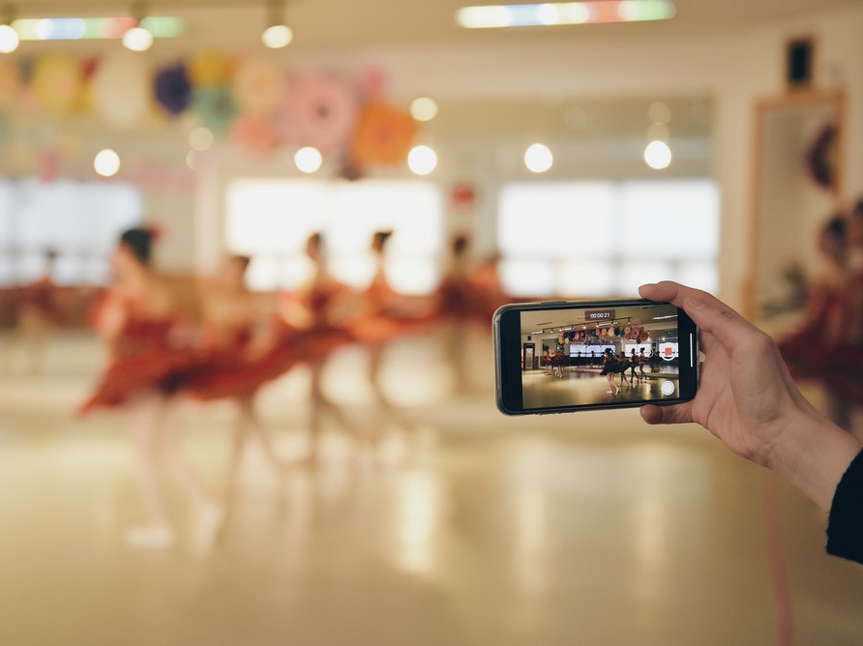
3. What live-to-digital is being created?

Slide 14
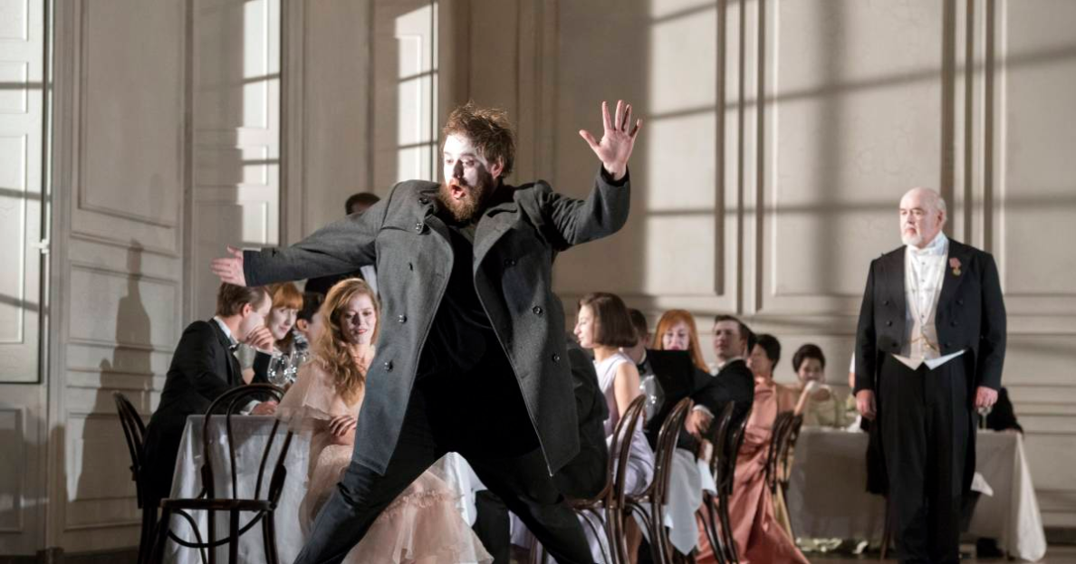
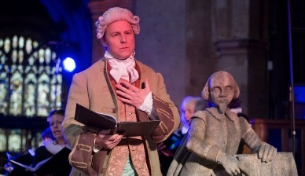
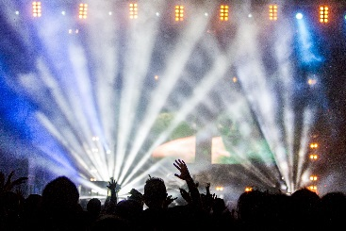
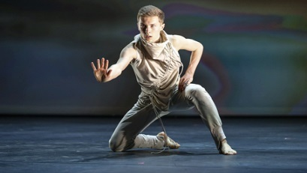
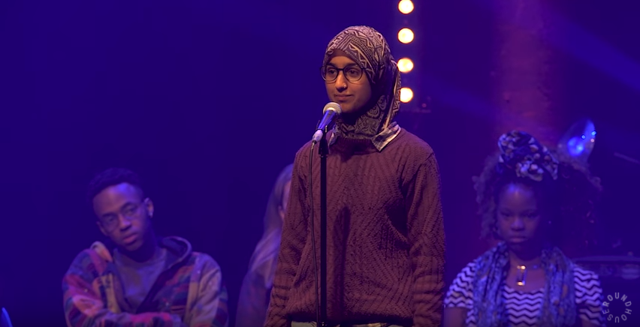
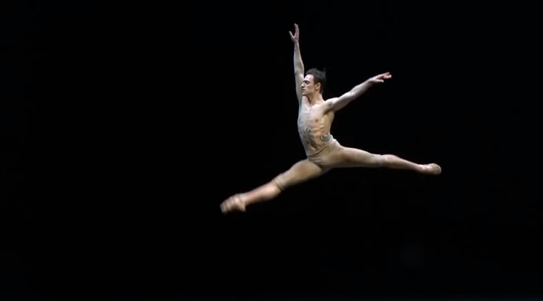
What we mean by ‘live-to-digital’
Defining live-to-digital
At its simplest, we define live-to-digital arts as a live performance, event or experience captured and distributed digitally, through television, online, cinemas or other venues. The content is recorded live but does not need to be distributed live.
The following activities are within the scope of our definition of live-to-digital arts content:
Live streamed video or audio of a whole performance or event e.g. a full opera or ballet broadcast live in a cinema, a band’s full music set broadcast live on TV or online
Hamlet from Glyndebourne live in cinemas © Glyndebourne Productions Ltd. Photo: Richard Hubert Smith
Ex Cathedra’s performance of Shakespeare Odes at Holy Trinity Church, Stratford on Avon’
BBC transmission of Radiohead Glastonbury set
Recorded video or audio of whole performance or event e.g. a full opera, ballet or music set recorded live but then watched later
Recorded video or audio of whole performance or event e.g. a full opera, ballet or music set recorded live but then watched later
Hamlet from Glyndebourne live in cinemas © Glyndebourne Productions Ltd. Photo: Richard Hubert Smith
Ex Cathedra’s performance of Shakespeare Odes at Holy Trinity Church, Stratford on Avon’
BBC transmission of Radiohead Glastonbury set
Video or audio of parts of a performance or event e.g. a video of one dance performance taken from a bigger dance competition featuring multiple performances
Sergei Polunin dance performance to Take Me To Church on YouTube
Connor Scott performance on BBC Young Dancer on YouTube
Spoken word performance from Roundhouse Poetry Slam finalist Suhaiymah Manzoor-Khan on YouTube
Sergei Polunin dance performance to Take Me To Church on YouTube
Connor Scott performance on BBC Young Dancer on YouTube

Slide 15
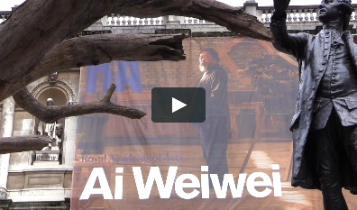
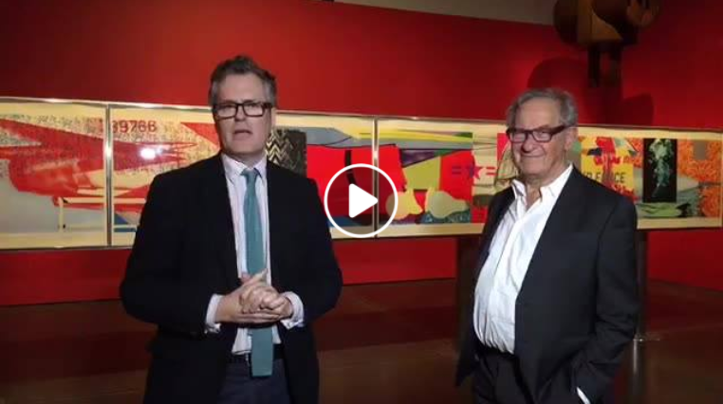
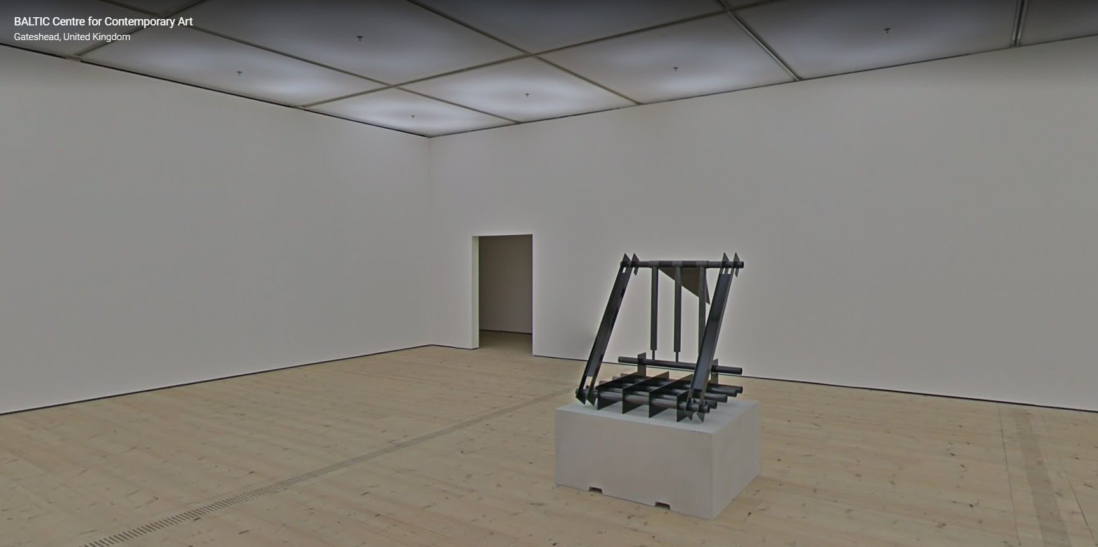
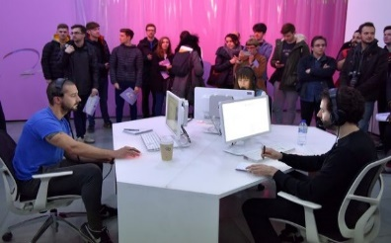
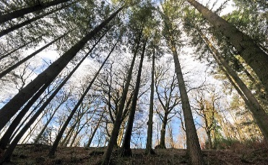
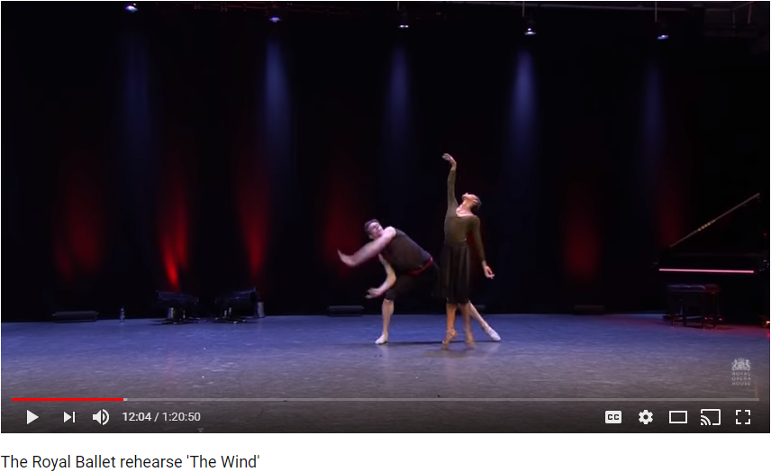
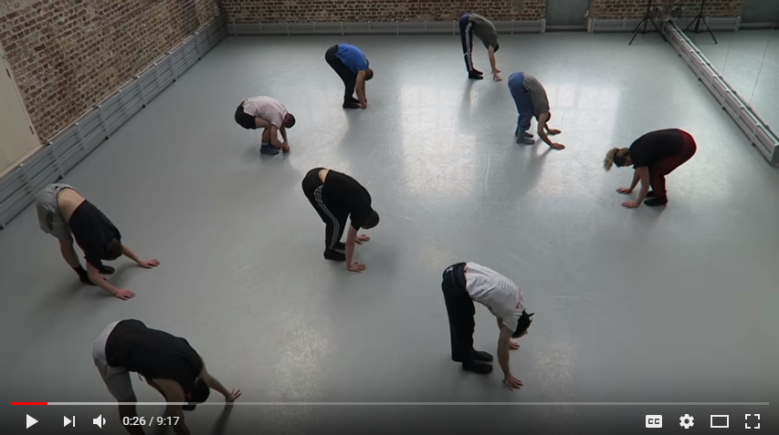
More examples of ‘live-to-digital’
Defining live-to-digital
Digital version of an installation, exhibition or physical site e.g. a virtual tour of a museum online in which you can move through the collection, getting a 360-degree view
Virtual tour of the Ai Weiwei exhibition at the Royal Academy
Facebook Live tour of the British Museum’s American Dream exhibition
Google Arts & Culture virtual tour of BALTIC Centre for Contemporary Art
Artistic or cultural work that uses live-to-digital as part of its core concept e.g. a performance piece where the artists video stream what they are doing live over the internet, inviting viewer interaction
FACT’s Touch My Soul live streamed participatory performance. Image by Brian Slater, courtesy of FACT.
In the Eyes of the Animal online version of immersive VR experience of Grizedale Forest created using 360° cameras
HEWILLNOTDIVIDE.US live streamed participatory performance
Event or talk associated with an artwork, performance, exhibition or collection e.g. a behind the scenes video showing a dance or music rehearsal or an interview with an artist, performer or curator
Live recordings of The Royal Ballet rehearsal performances on YouTube
Live recordings of Tate Talks artist interviews on YouTube
Behind the scenes footage of Ballet Boyz rehearsing on YouTube
We excluded from our definition:
Individual static digital assets: reproductions of paintings or sculptures documented for archival purposes
Advertising and marketing: content created specifically to advertise a ‘real-world’ event, which isn’t necessarily intended to be a full artistic or cultural experience, e.g. trailers
Highly edited videos of performances: where the video of a performance is very different from the ‘real world’ experience e.g. Ballet Boyz’ ‘Young Men’ film
Notes:
Image credits:
Ai Weiwei: https://www.royalacademy.org.uk/exhibition/ai-weiwei-360
BALTIC and Google Arts & Culture: https://www.google.com/culturalinstitute/beta/streetview/baltic-fifth-floor/dgFuVeCXRtP4XQ?sv_lng=-1.598261983482189&sv_lat=54.96928980162971&sv_h=342.26&sv_p=-13.299999999999997&sv_pid=sDJmiM3SgmQAAAQ4hFjMrw&sv_z=0.9999999999999997
FACT’s Touch My Soul: http://touchmysoul.net/
In the Eyes of the Animal: http://iteota.com/experience/welcome-to-the-forest
Tate – Modigliani VR: http://www.tate.org.uk/whats-on/tate-modern/exhibition/modigliani/modigliani-vr-ochre-atelier
Royal Opera House ballet performances: https://www.youtube.com/channel/UCHS5XKgf2FCBF8pZllE_bjw
CVAN – Make Practice Perfect: https://www.youtube.com/watch?v=xF-hCSGCxy8

Slide 16
Who is creating live-to-digital?

Slide 17
These results are from a survey of arts and cultural organisations in England
Who is creating live to digital?
Arts and Culture Organisation Survey
An online survey was completed by 211 participants, from a range arts & culture organisations across England (excluding theatre). Respondents had previously taken part in Arts Council England’s and Nesta’s Digital Culture survey and had indicated a willingness to take part in further research.
65% of this sample reported that their organisation had produced live-to-digital content in 2016/17, equating to 138 organisations.
The remaining 35% had not produced live-to-digital content in 2016/17, which equates to 73 organisations.
The next two slides describe the characteristics of the organisations who took part in our survey, looking at those who did produce live-to-digital content in 2016/17, and those who did not
Our sample of organisations, while not robustly representative, included a good spread of art forms and organisation types and results can be thought of as indicative of the arts & culture sector as a whole

Slide 18
The organisations who had not produced live-to-digital content were more likely to be non-performance based
Who is creating live to digital?
Organisations who produced live-to-digital content in 2016/17
Organisations who did not produce live-to-digital content in 2016/17
1%
1%
8%
11%
22%
22%
10%
15%
9%
10%
4%
12%
12%
15%
25%
23%
NET: Performance arts: 45%
NET: Non-performance arts: 44%
NET: Performance arts: 35%
NET: Non-performance arts: 57%
Source: B2B survey conducted by MTM. Q61: In which one of the following areas is your organisation most active. Base: Organisations who produced live-to-digital in 2016/17 (n=138) Organisations who did not produce live-to-digital in 2016/17 (n=73)
Notes:
Q54: Please select the region where your organisation is based. If you operate in more than one region, please select the one in which your main office or premises is located. Base: All organisations surveyed (n=211)
Q56: Please state your organisation’s current annual turnover in your most recent reported financial year.
Base: All organisations surveyed (n=211)
Q60: In which of the following areas is your organisation active? We have used the standard Arts Council England categories where possible.
Base: All organisations surveyed (n=211)

Slide 19
Those who hadn’t produced live-to-digital also tended to have lower turnover – with over half reporting under £100k
Who is creating live to digital?
Organisations who produced live-to-digital content in 2016/17
Organisations who did not produce live-to-digital content in 2016/17
Turnover
Turnover
Under £100k
£100k-£499k
£500k+
Not specified
Under £100k
£100k-£499k
£500k+
Not specified
Source: B2B survey conducted by MTM. Q61: In which one of the following areas is your organisation most active? Q56: Please state your organisation’s current annual turnover in your most recent reported financial year. Base: Organisations who produced live-to-digital in 2016/17 (n=138) Organisations who did not produce live-to-digital in 2016/17 (n=73)
Notes:
Q54: Please select the region where your organisation is based. If you operate in more than one region, please select the one in which your main office or premises is located. Base: All organisations surveyed (n=211)
Q56: Please state your organisation’s current annual turnover in your most recent reported financial year.
Base: All organisations surveyed (n=211)
Q60: In which of the following areas is your organisation active? We have used the standard Arts Council England categories where possible.
Base: All organisations surveyed (n=211)

Slide 20
What live-to-digital is being created and how is it distributed?

Slide 21
Video or audio recordings of a performance or event are the most common types of live-to-digital
What is being created and how is it distributed?
Non-performing arts organisations including museums are much more likely to have produced live-to-digital which consists of an event or talk than performing arts organisations (61% of nonperforming arts organisations versus 21% of performing arts organisations). This was in line with our expert interviews, which revealed museums and visual arts organisations frequently live streaming talks
In contrast, performing arts organisations who undertook live-to-digital are more likely to have produced live streamed video or audio of whole performances or events (46%) than the non-performing arts including museums (34%)
Types of live-to-digital content produced in 2016/2017 by those who engaged in live-to-digital
We have found that filming hip hop dance performances and uploading these onto a dedicated YouTube channel works particularly well. The younger generation is very comfortable with filming, uploading and releasing their work
- Dance organisation
Source: B2B survey conducted by MTM. Q1b: Please indicate below which, if any, of the following types of live-to-digital content you made in 2016, or so far in 2017. Base: Organisations who have produced live-to-digital content in 2016/17 (n=138)
Notes:
Image credit:
British Museum: Life and Death in Pompeii and Herculaneum http://www.britishmuseum.org/whats_on/exhibitions/pompeii_and_herculaneum.aspx

Slide 22
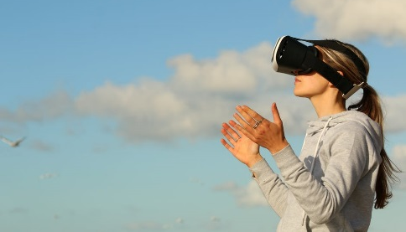
Video and audio are the most common formats, but some are experimenting with 360, VR and AR content
What is being created and how is it distributed?
Formats of live-to-digital content produced in 2016/2017 by those who engaged in live-to-digital
*
360 degree video, VR and AR are less common, but some organisations are experimenting in this area. Examples include:
Liverpool Biennial’s augmented reality app, Dazzle It, which allows you to wrap images around a 3D model using augmented reality
English National Ballet’s two-minute immersive piece inspired by Akram Khan’s Giselle sees the lead principal, Tamara, performing around the viewer in 360 degrees leaving behind a 3D trail of light and dust which shows the course of her movements.
Video and audio are the most commonly produced formats of live-to-digital content.
Altogether, 96% have created either video or audio live-to-digital
Audio is the most common format for visual arts and literature organisations, as well as for music.
* 360 degree video - video recordings where a view in every direction is recorded at the same time; Virtual Reality (VR) – a computer-generated scenario that simulates a realistic experience; Augmented Reality (AR) – a technology that superimposes a computer-generated image on a user’s view of the real world
Source: B2B survey conducted by MTM. Q3: In which formats have you produced live-to-digital content? Base: Organisations who have produced live-to-digital content in 2016/17 (n=138)

Slide 23
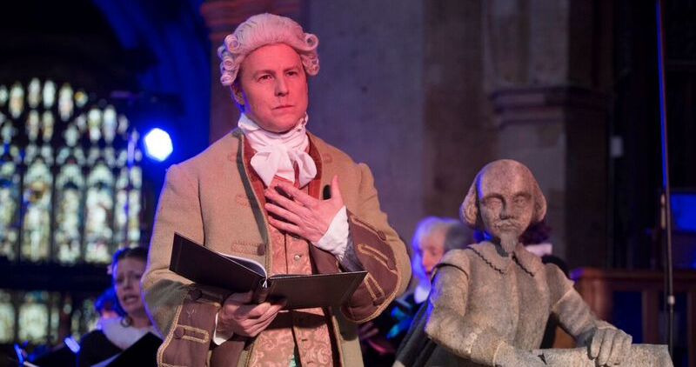
Music case study: Ex Cathedra - Shakespeare Odes (2016)
Case Study
Birmingham-based Ex Cathedra is a leading UK choir with a focus on historically-informed performances and a track record for commissioning and premiering new work
Project context:
To commemorate the 400th anniversary of Shakespeare’s death, Ex Cathedra reconstructed an 18th-century Ode to Shakespeare and commissioned a 21st-century counterpart. The first of six live performances in 2016 was at Holy Trinity Church in Stratford upon Avon. The audio was live-streamed on BBC Radio 3 and the video with Radio 3 audio was live-streamed on the BBC Arts website. After the event, it was available on iPlayer.
Four cameras and jib were used to capture the live performance for streaming
Samuel West as David Garrick in Ex Cathedra’s performance of Shakespeare Odes at Holy Trinity Church, Stratford on Avon
It was quite an expensive project to undertake. It would not be something that an organisation of our size would necessarily be able to repeat without funding, simply because of the cost
- Peter Trethewey, General Manager
Objectives:
Reach: to extend the reach of the project to a wider and more diverse audience
Brand building: to raise awareness of Ex Cathedra and showcase the quality and range of their work
Impact:
Ex Cathedra were pleased with the additional reach achieved through the live stream of the performance
Ex Cathedra were initially concerned that the live-stream might adversely affect ticket sales. However, this did not happen and instead, they found that the live-stream significantly extended reach beyond those who came to watch the live performance.
Key stats
29,000 people overall watched, listened or took part
12,120 views on iPlayer
3,100 listeners on BBC Radio 3

Slide 24
Music case study: Ex Cathedra - Shakespeare Odes (2016)
Case Study
Planning and partnerships:
The commissioning of the contemporary work was done in collaboration with The Shakespeare Birthplace Trust and The Shakespeare Institute.
The visualisation was funded by British Council and Ex Cathedra worked with the BBC to advise on the employment of external contractors to direct, film and produce the production and provide equipment.
We sought advice from the BBC about who to engage as visualisation director and camera operators as that’s not our area of expertise. We used a company external to the BBC to provide all the camera equipment and crew.
We would be interested in doing another live-to-digital project but I think it’s about finding the right project and the right moment. It’s also about having the right partners on board
- Peter Trethewey, General Manager
Lead time: 6 months
Cost
c. £40,000
This was used to pay for a visualisation director, contracted camera operators and other crew needed to make the live stream possible
Distribution channels:
Key take outs and implications for organisations:
Partnerships are key: Working in partnership with other organisations such as broadcasters can help fill skills gaps e.g. technical knowledge about equipment and can also extend reach.
Live-to-digital can really magnify an event: Live-streaming can work particularly well if it is part of a wider festival / programme of events by reaching a far greater number of people than attend the ‘real-world’ event
Live streamed on BBC Radio 3 and the BBC website as part of the Shakespeare Digital Festival
Available on-demand for 6 months on iPlayer & online
Marketing: BBC promoted the Shakespeare Digital Festival across all of its platforms. The BBC Arts website also promoted the Festival in the banner at the bottom of the homepage.
Ex Cathedra marketed their 6 performances and the live streams directly to audiences via its website, email newsletters and social media.
Notes:
Other quotes:
“Inevitably, there was a concern that the live streams might mean that fewer people bought tickets but the flipside of that is that you might get some people who wouldn’t have otherwise known about it, seeing it, and then thinking that they want to see it live”

Slide 25
Our expert interviews revealed live-to-digital is most developed in the performing arts
What is being created and how is it distributed?
Music, dance and opera have more formal and regular live-to-digital output than the non-performing arts and museums as they have a ready-made performance which naturally lends itself to video or audio capture
Live-to-digital is well established for the larger opera, dance and music organisations e.g. The Royal Opera House and Glyndebourne, who use multiple channels including cinema, TV and online to transmit live and encore performances. The Royal Opera House and Glyndebourne have highly developed event cinema programmes. The Royal Opera House Live Cinema Season 2017/18, for instance, included 6 Royal Opera and 6 Royal Ballet productions screened live in cinemas across the world
Dance and opera performances are also broadcast on BBC Four or Sky Arts e.g. Verdi’s Otello and BBC Young Dancer on BBC Four
There is considerable reticence across the performing arts organisations we spoke to about giving away whole performances for free online, and rights issues restrict the amount of content which is readily available online. Consequently, full-length high quality performances are not regularly distributed through platforms like YouTube. That said, organisations like The Space and BBC Arts do facilitate the funding and dissemination of full live-to-digital performances through their respective YouTube channels and websites
YouTube and Instagram feature a broad range of short dance and opera performances and clips from a diverse range of companies, for example Theo ‘Godson’ Oloyade – Hell’s Gate 7 at Breakin’ Convention (an international hip-hop dance festival) and Rambert’s performance of Goat.
Tate have to work very hard to make live-to-digital engaging whereas ballet and opera is live, immersive and performative so doesn’t have to work as hard. What are you supposed to do with inert sculpture?
- Opera organisation
It is much easier to work with emerging artists and it is much trickier when doing things like musicals because there’s a lot more work around rights and material
- Combined Arts Organisation
Source: expert interviews conducted by MTM

Slide 26
There is a wide range of mainstream and niche live-to-digital music and festival output
What is being created and how is it distributed?
In the commercial music realm, the major festivals are the dominant players, including Glastonbury, Reading and Leeds festivals, Latitude and Radio 1’s Big Weekend, which are live streamed on TV to large audiences
In addition to these longer-form experiences, there are a plethora of short-form performances from Radio 1’s Live Lounge series available via YouTube and BBC iPlayer, to more niche commercial offerings like videos of Sofar Sounds secret gigs and intimate concerts on YouTube
Live-to-digital music screened in the cinema is less common than opera or dance but it does exist, encompassing everything from popular music e.g. Take That Live from the O2 to classical concert performances e.g. The Berlin Philharmonic
Publicly funded music organisations such as Celebrate Life Events and Psappha use YouTube as a means of showcasing new work and emerging musicians and reaching a younger audience
Organisations also collaborate with broadcast partners like the BBC to get their audio-visual output out to larger audiences through radio, TV and online e.g. Birmingham Contemporary Music Group, who regularly work with BBC Radio 3
We regularly collaborate with BBC Radio 3 who record and distribute our performances. We have positive feedback from audiences that they enjoy listening to our performances through BBC distribution platforms (typically live radio and iPlayer)
- Music organisation
We believe that live-to-digital helps our brand grow and gives credibility to our work particularly to a younger audience - Music organisation
As a new music ensemble the content we create for our YouTube is generally a piece of music that isn't already on YouTube. Our views in 2016/17 were more than 44,000. We carefully select elements from performances to add to the channel as well as promoting the work of emerging composers
- Music organisation
Source: expert interviews conducted by MTM

Slide 27
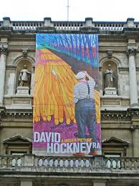
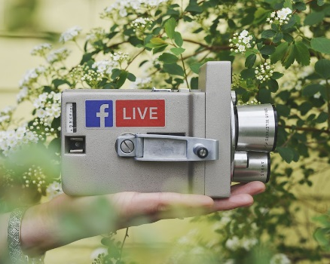
Galleries and museums engage in live-to-digital on a less regular basis than performance based artforms
What is being created and how is it distributed?
Visual arts organisations and museums are grappling with how to translate their often static ‘real world’ offer into a dynamic live-to-digital experience
As a result, large-scale live-to-digital is less common in the visual arts and museums than in the performing arts, though large galleries and museums such as Tate, the National Gallery, the V&A and the British Museum have all broadcast live exhibition experiences of their blockbuster shows into the cinema e.g. Pompeii Live from the British Museum (2013)
Specialist production companies such as Exhibition on Screen create event cinema experiences which include David Hockney at The Royal Academy of Arts and Cézanne Portraits of a Life
Visual arts organisations and museums are increasingly engaging in low cost live-to-digital such as Facebook and Instagram Lives of performance pieces (e.g. Tate’s live stream of London Fog, Fujiko Nakaya’s immersive fog sculpture) and expert led gallery tours (e.g. BALTIC’s Bloomberg New Contemporary Exhibition) .
Google Arts and Culture is also facilitating the dissemination of a broad range of museum collections internationally, including that of the British Museum, through the 360 degree gallery experiences hosted on their website
For us really, Facebook Live which we started using last June since we reopened the new building is a perfect balance of very low cost, decent quality and big reach
- Visual arts organisation
We haven’t reached a point where we have a regular schedule of live streams on Facebook as it depends on opportunities, the availability of spaces and experts as well as timings. But we do have a reasonably large audience on Facebook, around 1.5 million followers.
- Museum organisation
Source: expert interviews conducted by MTM

Slide 28
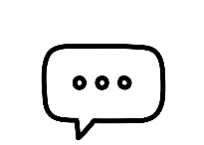
Museums case study: British Museum – The American Dream exhibition tour, Facebook Live (2017)
Case Study
The British Museum holds in trust for the nation and the world a collection of art and antiquities from ancient and living cultures
Project context:
The British Museum has been doing live broadcasts on social media for about 3 years. They use Facebook Live to take audiences behind the scenes and to explore permanent galleries outside of opening hours. They try to do at least one live broadcast for each exhibition.
The museum invited art historian Simon Schama to do a Facebook Live gallery tour of their The American Dream: Pop to the Present exhibition with its curator. During the tour they picked specific works to discuss and viewers were invited to comment and ask questions.
When we go ‘live’ it creates a global community of people coming together. Our Facebook followers are 85% overseas, and when we ask them to tell us where they’re watching from it’s great to see the diverse responses.
- Kate Carter, Senior Digital Marketing Manager
Objectives:
Reach: to give those around the UK and abroad an opportunity to experience the exhibition
Brand building: to position the British Museum as a home for modern and contemporary art and to encourage exhibition ticket sales.
Impact:
Increasingly The British Museum looks at the rate of engagement across social platforms (in terms of reactions, comments, shares) to assess performance. This post definitely delivered on international reach as was illustrated by the large number of people commenting
Some of the [Facebook Lives] we’ve done recently we’ve had comments from 90 countries -there’s nothing else we do that has that sense of creating a moment
- Kate Carter, Senior Digital Marketing Manager
Key stats
100 thousand views
1.1 thousand reactions
238 comments

Slide 29
Museums case study: British Museum – The American Dream exhibition tour Facebook Live (2017)
Case Study
Planning and partnerships:
Planning is essential; extensive checks are done before the broadcast to test WIFI connection, sound quality and lighting and the presenters meet to discuss the works they will talk through. Consideration is also given to when the broadcast takes place – in this case it was aired later in the day to reach an American audience.
The project was filmed by the marketing department on a smartphone with the aid of a gimble (to steady the camera), lighting and a boom mic (to ensure audio quality).
We always make sure that a ‘live’ is exclusively for the online audience. So we’ve never created a live where we were just doing it anyway because we want the experience to be for the digital audience
One of the things we’ve found really good is that when we start our live broadcasts off we get people to tell us where they’re watching from…We get this phenomenal response. I think people find it really exciting
- Kate Carter, Senior Digital Marketing Manager
Lead time: 1 month to plan
Cost
c. £300 - £1,000
Facebook Live is seen as relatively cheap. The cost in this instance was for a boom mic, lighting and a gimble
Distribution channels:
Key take outs and implications for organisations:
Facebook Live has great potential for international reach: The British Museum’s Facebook Lives regularly reach people in up to 90 countries
Planning is essential: there is no post-production so to ensure a successful broadcast a clear idea of the agenda for the broadcast as well as testing of sound and lighting is important
Pre-promotion is key: it takes time to build an audience on Facebook Live so notifying an engaged audience ahead of time either through Facebook or other channels will ensure you’re not going from a standing start
Live streamed on Facebook and then boosted to target audiences
Marketing: Advertised through social media platforms (including paid promotion to a London and UK-based audience) and email marketing. Paid-for advertising on Facebook following the event helped extend the audience.
Pre-promotion is key to building an audience; it makes sure people interested in your subject are primed.

Slide 30
The primary form of live-to-digital in literature other than book readings/talks is spoken word poetry
What is being created and how is it distributed?
Videos of spoken word tend to be disseminated on YouTube to a small, though engaged, audience
Organisations engaged in this activity include The Roundhouse which has its annual Last Word Festival Poetry Slam Final, which it films and posts on YouTube, as well as Apples and Snakes and Hammer and Tongue, which showcase the work of up and coming performance poets
However, there are also examples of spoken word poets who are reaching bigger audiences including George the Poet (who’s Search Party app collates his poetry to drive social action), Hollie McNish and Kate Tempest who have garnered sizable followings online, particularly as a result of the convergence of music and poetry in their work. YouTube actively supports and mentors a number of spoken word performers under its ‘Creators’ programme.
Outside the performance side of literature, experts indicated there are an array of videos of book readings & interviews with authors, examples of which can be found on the YouTube channels of literary festivals e.g. Hay.
Over the year we decide what we’d like to stream and we discovered that working with emerging artists is easier. For Poetry Slam it’s relatively straightforward; for me, it’s about taking the performance beyond who is in the room at the time
- Literature organisation
Source: expert interviews conducted by MTM

Slide 31
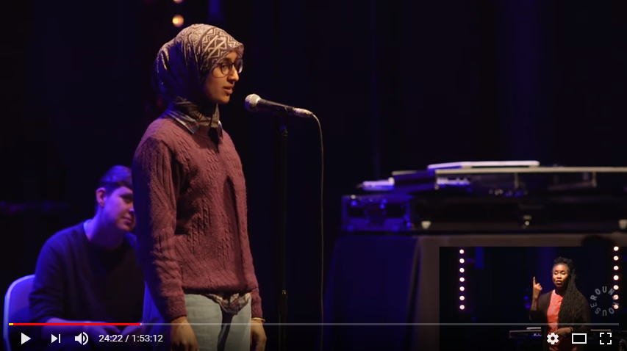
Literature case study: The Roundhouse – Poetry Slam (2017)
Case Study
Roundhouse is an event space and arts organisation that promotes emerging talent and encourages youth engagement in the arts
Project context:
The Roundhouse runs an annual Poetry Slam in which young spoken word poets compete. As part of a wider decision to live stream performances from their Emerging Artist programme, Roundhouse live streamed the final of the 2017 Poetry Slam competition on Facebook and YouTube.
Roundhouse used 4 cameras (3 camera operators and 1 locked-off wide camera) to capture the live performances. 5 internal, and 5 external staff were involved in facilitating the live-stream of the performances.
Suhaiymah Manzoor-Khan, the runner up from Poetry Slam 2017
I think we could really benefit with some support from Facebook Live. We had no technical support from Facebook and so it’s not something I feel super-confident with if we run into a problem
- Claudia Lee, Film and Broadcast Producer
Objectives:
Reach: to reach a wider, and international, audience beyond venue attendees
Brand building: To raise awareness of Roundhouse’s work and what the organisation can offer
Showcase talent: to showcase emerging young talent
Impact:
The live-stream significantly extended the reach of the performance (as shown below)
Roundhouse were pleased with the positive feedback received via Facebook comments
Poetry Slam resulted in The Roundhouse’s most-watched video on Facebook – Manzoor-Khan’s This is not a Humanising poem which has so far reached 1.9 million people
Key stats
70 people watched the live stream on YouTube / Facebook Live
39, 000 subsequent on-demand views of the final on YouTube and Facebook
Resulted in their most-watched poem on Facebook – almost 2 million views

Slide 32
Literature case study: The Roundhouse – Poetry Slam (2017)
Case Study
Planning and partnerships:
Roundhouse has found that it is easier to live stream performances by emerging artists because of rights issues involved with working with established artists. The live stream was broadcast on both YouTube and Facebook Live.
All the directing/filming was done in-house with Roundhouse equipment; Roundhouse employed young broadcast trainees they have trained to film the performance.
For me, it’s about taking the performance beyond those who are in the room at the time. It’s also great to let people know what our organisation does
We were able to look at the analytics of YouTube and see if people were watching for longer. With Facebook Live we had lots and lots of positive comments.
- Claudia Lee, Film and Broadcast Producer
Lead time: 1 month (with a few days of preparation before the event)
Cost
c. £1,500
This was used to pay for external staff to support the live-stream e.g. camera operators, a director and vision mixer
Distribution channels:
Key take outs and implications for organisations:
Live-to-digital projects don’t have to be expensive / complex: YouTube and Facebook are accessible and inexpensive platforms for broadcasting live-to-digital projects
Broadcasting on YouTube and Facebook provided analytic capabilities: Roundhouse benefitted from knowing the age and gender of those watching the live-stream on YouTube, as well as their length of engagement. Facebook also enabled Roundhouse to gather feedback on the live-stream
Live streamed on Facebook Live
Live streamed on YouTube
Marketing: Promoting the project ahead of the live stream was difficult due to the fact that the majority of the finalists were not London based and Roundhouse’s resources were limited.
Notes:
Other quotes:
“Inevitably, there was a concern that the live streams might mean that fewer people bought tickets but the flipside of that is that you might get some people who wouldn’t have otherwise known about it, seeing it, and then thinking that they want to see it live”

Slide 33
Online is by far the most common method of distribution, followed by physical venues and then TV
What is being created and how is it distributed?
Of the survey respondents who made live-to-digital content in 2016/2017:
96%
Used online platforms for distribution of live-to-digital content
39%
Used physical venues for distribution
6%
Distributed live to digital content via TV
Physical venues
TV
Source: B2B survey conducted by MTM. Q2a: Which, if any, of the following online platforms did you use to distribute that live-to-digital content in 2016/2017? Q2b: Was your live to digital content made available in any of the following types of venue? Q2c: Was your live-to-digital content shown on broadcast or on-demand TV?. Base: Organisations who have produced live-to-digital content in 2016/17 (n=138)

Slide 34
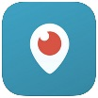
Easy-to-use and cheap online platforms like Facebook and YouTube are popular for distributing content
What is being created and how is it distributed?
Boxes show most common types of live-to-digital content for each platform
Platforms used to distribute live-to-digital content in 2016/2017
Video/audio of parts of a performance/ event
Event/ talk associated with an artwork
Digital version of an installation or exhibition
Work that uses live-to-digital as part of its core concept
Live streamed whole performance
Under 5% for all types of live-to-digital content
Since we started using Facebook Live last June, it’s been the perfect balance of very low cost, decent quality and big reach
- Visual arts organisation
Facebook Live is the optimum channel because, unlike YouTube, you also get the social media aspect such as being able to share it
- Combined arts organisation
Source: B2B survey conducted by MTM. Q2a: Which, if any, of the following online platforms did you use to distribute that live-to-digital content in 2016/2017?. Base: Organisations who have produced Live-to-Digital content in 2016/17 (n=138)

Slide 35
The launch of YouTube, YouTube Live and Facebook Live have coincided with uptakes in live-to-digital
What is being created and how is it distributed?
When organisations started producing live-to-digital
32%
17%
20%
11%
11%
9%
More than 10 years ago
5-10 years ago
2014
2015
2016
2017
Whilst a substantial proportion of organisations started producing live-to-digital in 2014 or later, some claim to have started much earlier. The majority of these are performing arts organisations
The launch of YouTube in 2005, and YouTube live functionality in 2011 coincided with a marked growth in live to digital output
The launch of Facebook Live in 2016 coincides with a notable uptake of live-to-digital production
Source: B2B survey conducted by MTM. Q4: When did your organisation first start producing live-to-digital content? Base: Organisations who have produced live-to-digital content in 2016/17 (n=138)

Slide 36
Over a quarter of organisations say live-to-digital is part of all or most of their output
What is being created and how is it distributed?
How central live-to-digital is to organisations’ output
Of organisations who produce live-to-digital, 6% claim everything they do has a live-to-digital element
And a further 20% say they incorporate live-to-digital into the majority of their work
We produce live-to-digital
for a select few
performances/ exhibitions
We have produced live-to-digital
once or twice in 2016/2017
We incorporate live-
to-digital into the
majority of our work
The relationship between our live audiences and live-to-digital audiences is a very complementary one… we broadcast three of our operas in cinemas and supplement this with a television broadcast of another one. In addition, we also produce a number of digital opera guides
- Opera organisation
Everything we do has a live-to-digital element to some degree
Other
Source: B2B survey conducted by MTM. Q5: Generally, how often would you say your performances or exhibitions in 2016 and 2017 have involved a live-to-digital element? Base: Organisations who have produced live-to-digital content in 2016/17 (n=138)

Slide 37
Why are organisations creating live-to-digital and how successful has it been?

Slide 38
Organisations produce live-to-digital for many reasons - driving reach is the most important, revenue the least
Why live-to-digital? And how successful has it been?
Reasons for producing live-to-digital content
To reach a larger audience
To reach a more diverse audience
To engage more deeply with our existing audience
To provide new experiences for audiences
To reach a new audience
To push artistic boundaries
To boost our public profile
As a marketing exercise
To serve the educational sector
To make the most of new technology
To build our brand
To generate revenue
Other
Reach is a key reason to engage in live-to-digital. Over a third of organisations say reaching a larger audience is the main reason to produce live-to-digital. An important aspect of live-to-digital is also reaching a more diverse audience from the one who might consume the ‘real-world’ offer
Just under a third of organisations say a reason to create live-to-digital is to push artistic boundaries
Brand building and boosting public profile is a consideration for many, though rarely the main reason for producing live-to-digital
Revenue generation is low on the list of motivations for producing live-to-digital – currently 93% do not regard it as a reason
Source: B2B survey conducted by MTM. Q6: What are the main reasons why you produce live-to-digital content? Q7: And which was the main reason you decided to produce live-to-digital content? Base: Organisations who have produced live-to-digital content in 2016/2017 (n=138)

Slide 39
Arts organisations strive to create live-to-digital which is distinct from and enhances the ‘real-world’ experience
Why live-to-digital? And how successful has it been?
Many organisations we spoke to during our expert interviews saw live-to-digital as distinct and valuable from the ‘real-world’ experience, not just a replication
Across artforms, organisations were preoccupied with creating digital experiences which offered clear ‘added value’
In the visual arts and museums for instance, this consisted of Facebook Live gallery tours in which the works you see are further illuminated by expert commentary (something you rarely get when attending the ‘real-world’ event) e.g. a tour of Tate Britain’s JMW Turner collection with an expert
For opera and dance live streamed in cinemas, this was about getting better and more varied views of the performers than you could hope to achieve attending the venue in person, or a presenter interviewing the artists or composers in the intermission e.g. the Royal Opera House’s Rigoletto
Considerable reference was also made to the potential interactive aspect of live-to-digital; whether that’s viewers influencing the outcome of an artwork directly as was the case of Touch My Soul or commenting on a Ballet Boyz reahearsal on YouTube Live
The museum is brought alive when it is explained to you. When you go around a museum yourself there’s so much you have to fill in, whereas when a curator explains it in a piece of live-to-digital it really enhances the experience
- Museum
There’s a whole load of added value stuff we do with the event cinema performances, from live presenters in the venue to interspersing the performance with interviews
- Dance organisation
A live-to-digital experience may have many components – you might have at the heart of it a performance and then a social media campaign
- Broadcaster

Slide 40
Combined arts case study: FACT – Touch My Soul (2015)
Case Study
FACT (Foundation for Art and Creative Technology) is a media arts centre based in Liverpool, offering a unique programme of exhibitions, film and participant-led art projects
Project context:
As part of FACT’s 2015 exhibition Follow, the artist collective LABEOUF, RÖNKKÖ & TURNER undertook a piece of performance art in which they live-streamed themselves answering phone calls as callers attempted to ‘touch their souls’ over a period of 3 days. The artists continuously updated a Google Doc with the conversations they had with callers.
The project culminated in LaBeouf getting a quote a caller had provided – “You.Now.Wow.” tattooed on his body.
Image by Brian Slater, courtesy of FACT
We massively surpassed expectations with the number of people tuning in and conversations people were having about the project. There were a large number of younger people who engaged
- Lesley Taker, Producer/Curator at FACT
Objectives:
Create an interactive work to reach beyond the gallery
Explore the potential for digital tools to be incorporated into the development of artworks
Appeal to a younger audience: to design a project that would particularly attract a younger demographic
Address the theme of identity in social media: the project was designed to discuss the ability to have an authentic moment on social media.
Impact:
FACT were pleased with the very large number of unique hits achieved by the live-stream
The performance succeeded in reaching a younger audience, who not only viewed the performance, but also engaged with the rest of the gallery as well
They found that this particular exhibition increased awareness of FACT and its work
Key stats
271,000 live stream views
3,129 people in the gallery

Slide 41
Combined arts case study: FACT – Touch My Soul (2015)
Case Study
Planning and partnerships:
FACT collaborated with LABEOUF, RÖNKKÖ & TURNER to live-stream their performance of Touch My Soul. New Hive provided a streaming package and support during the live-stream for free, in return for New Hive’s logo being featured. FACT hired two 4k cameras to do the filming.
A few days before the performance, the cameras, phone system and live-streaming were set up in the gallery.
We saved all of the videos so they’re still playing on the TMS.net website now and it’s backed up on the collective’s servers so it’s there for them to be able to use if they want to show it as a documentary or as a retrospective exhibition
You were in an interesting position where, to have the most complete (and authentic) experience, you had to engage cross-platform. For example, just being inside the gallery meant you were missing most of the content of the conversations happening online and on the other end of the phone.
- Lesley Taker, Producer/Curator at FACT
Lead time: 4 months (with more focused planning beginning 4 weeks before the performance)
Cost
This covered the artist fee (£500) for the development of the commission and the cost of materials and labour (£800).
£1,300
Distribution channels:
Key take outs and implications for organisations:
Live-to-digital can offer more than real-world performances: The real-world performance did not allow viewers to listen in on the conversations, but by following the live-stream, the Twitter hashtag and the Google Doc viewers could hear/see the conversations the artists were having on the phone
Archiving: Having the live-to-digital element of the project allows the possibility of the project being shown again in the future
Live streamed on touchmysoul.net. The videos are still available to watch.
Marketing: A Twitter hashtag (#touchmysoul) was used to promote the event on social media as well as to engage audiences.
On the morning of the press opening of the performance a press statement with a single photograph was sent to FACT’s contacts including critics and art publications.

Slide 42
Organisations are looking to reach a broad range of new and existing audiences with live-to-digital
Why live-to-digital? And how successful has it been?
Audiences that organisations aim to serve via live-to-digital
Any audience that has not yet seen our work
National audiences who are, geographically, further away from our venue(s)
International audiences
Any other audiences who otherwise may not be able to attend
Our existing live audience
Generally, a more diverse audience than we traditionally serve
Disabled audiences
Younger audiences than we typically reach
Rural audiences
Students in formal education - college/university
Students in formal education - primary/ secondary
Audiences for whom our live ticket prices might be a barrier
Older audiences than we typically reach
Other
Organisations view live-to-digital as having the potential to serve audiences who would otherwise be excluded from their work because of location, cost or ticket limitations.
Our expert interviews described using live to digital to target audiences who are not ordinarily engaged with their artforms (e.g. younger, less affluent or BAME audience groups).
Source: B2B survey conducted by MTM. Q8: Which of the following types of audiences do you aim to serve via live-to-digital? Base: Organisations who have produced live-to-digital content in 2016/2017 (n=137)

Slide 43
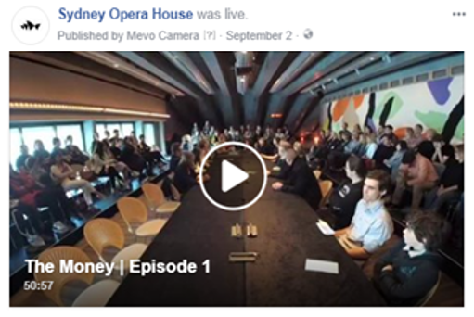
Combined arts case study: Kaleider – The Money (2017)
Case Study
Kaleider is an Exeter based production studio that brings people together to design, produce and promote extraordinary live experiences
Project context: The Money is Kaldeider’s hit ‘showgame’ which challenges audience members to spend a set amount of money in a set amount of time on whatever they choose.
In 2017, The Money toured to Australia and was performed in The Sydney Opera House and live streamed on The Sydney Opera House’s Facebook page
[Live-to-digital] increases the number of people engaging in the work and in the core idea of the work
- Seth Honnor, Artistic Director
Objectives:
Reach: to increase the number of people engaging and give people who would never go and see the live show an opportunity to see it
Driving interest: to teach people about the game and encourage people to attend a live show
Community building: to create a community around the show on social media
Impact:
Kaleider were pleased with the views received by the live-stream on The Sydney Opera House’s Facebook page.
Key stats
The last episode reached 165k people
104 likes on the last episode
56 comments

Slide 44
Combined arts case study: Kaleider – The Money (2017) continued
Case Study
Planning and partnerships: Kaleider’s Artistic Director managed the technical delivery, despite having limiting technical knowledge, operating the Mevo camera (controlled from an iPad) and the automixers. The Mevo camera is relatively cheap, user-friendly, gives the appearance of a multi-camera shoot and can stream straight to Facebook Live
Sydney Opera House live streamed the event on their Facebook channel extending reach massively.
We used a camera called Mevo because it doesn’t require expert operators, looks like a multi camera shoot and through it you can go straight to Facebook Live
It’s interesting the shift towards more affordable DIY methods of film delivery. It’s no longer the realms of big production companies
- Seth Honnor, Artistic Director
Lead time: Approximately 2.5 days
Cost
c. £1,500
Costs for the Mevo camera and second-hand automixers. The automixers were essential to distil and transmit the voices of a large group
Distribution channels:
Key learnings for other organisations:
Partnerships increase reach: streaming The Money through Sydney Opera House’s Facebook page dramatically increased audience size
Facebook gives you access to new audiences: re-posting broadens access to those who wouldn’t otherwise see the real-world show
Accessible tech: inexpensive and easy-to-use tech e.g. the Mevo camera, makes it possible for those with limited technical knowledge and budget to engage in live-to-digital
Audio is essential: the quality of the audio is extremely important in live-to-digital productions and should not be overlooked
Live streamed on Sydney Opera House’s Facebook page
Marketing: The ‘real world’ show was promoted heavily by Sydney Opera House but there were some reservations that the live stream may not work so that was only lightly promoted. The reach achieved on Facebook was fairly organic and Kaleider believes its success was largely driven by the compelling nature of the content shown

Slide 45
Only a small proportion say live-to-digital contributes to financial stability; only a quarter expect it to in the future
Why live-to-digital? And how successful has it been?
The majority of organisations who have produced live-to-digital content have done so without any expectations of it contributing to financial stability
Of organisations who have been producing live-to-digital….
Expected financial benefits organisations aim to achieve:
9%
Additional income through programming that appeals to new funders
Additional stream of earned income
Additional income through programming that appeals to new audiences
Replacement for declining income for live events/ performances
Replacement for traditional income from touring
None
Reported it is currently contributing towards financial stability
27%
Expect it will contribute towards financial stability in the future
36%
Do not expect it to contribute towards financial stability
Very few view it as a potential replacement for other income
31%
Don’t know whether it will or not
Source: B2B survey conducted by MTM. Q9: Do you feel that live-to-digital production currently is or will in the future contribute to your organisation’s financial stability? Q10: Which, if any, of the following types of financial benefits do you aim to achieve via live-to-digital? Base: organisations who have produced live-to-digital in 2016/2017 (n=138)

Slide 46
Organisations see live-to-digital as complementary to rather than cannibalising their ‘real world’ offer
Why live-to-digital? And how successful has it been?
47% of organisations see live-to-digital as a marketing opportunity. Rather than cannibalising the audience for ‘real world’ events, arts organisations see live-to-digital driving interest and ticket sales
People wouldn’t have known about the event otherwise so the live-to-digital element meant that people might ask where they could buy tickets.
- Music organisation
Who accessed your live-to-digital content in 2016/17?
Mostly new people who did not attend live
A good balance of new people and people who already attend your live performances/ exhibits
Mostly existing live audience
Don’t know
Does live-to-digital encourage people to engage with your live work?
What do your live audience do after engaging with your live-to-digital work?
12%
Yes – it drives significant numbers to our live work
26%
Attend more live performances/ events
45%
Continue to attend live as they did before
49%
Yes – but not significantly
0%
No negative effects on live attendance were perceived by organisations who produced live-to-digital
Attend fewer live performances/ events
8%
No – we don’t expect it to
0%
Stop attending live performances/ events
31%
Don’t know
29%
Don’t know
B2B survey conducted by MTM. Q18: Which of these do you think best describes the audiences who accessed your live-to-digital content in 2016 and 2017? Q19: Which of the following do you believe your live audience typically does after engaging with your live-to-digital content? Q20: Do you think your live to digital content has encouraged people to engage with your live work, when they had not done so before? Base: Organisations who have produced live-to-digital content in 2016/2017 (n=138)

Slide 47
Almost all organisations who produced live to digital in 2016/17 said they will continue doing it
Why live-to-digital? And how successful has it been?
Success levels
99% of organisations view live-to-digital as having been a positive experience
We now have a dedicated Content Officer in place and we’ll be ramping up our live to digital this year. We’re looking to do more live streaming of performances but also embed live-to-digital within our budget
- Dance Organisation
As soon as we are contemplating a new production or a world premiere, we would think about the digital opportunities alongside that
- Theatre Organisation
Source: B2B survey conducted by MTM. Q16: Which of these statements reflect how you feel about the live-to-digital work you have produced in 2016 and 2017? Base: organisations who have produced live-to-digital in 2016/2017 (n=138)

Slide 48
Most of those who have yet to produce live-to-digital are keen to do so and envisage it having positive impacts
Why live-to-digital? And how successful has it been?
Expected impact of producing live-to-digital amongst those who haven’t produced live-to-digital in 2016/17
79%
Reaching a larger audience
Reaching a new audience
Boosting our public profile
Providing new experiences for audiences
Building our brand
Reaching a more diverse audience
Engaging more deeply with our existing audiences
Promoting live performances/ exhibitions
Serving the educational sector
Making the most of new technology
Pushing artistic boundaries
Generating revenue
Of organisations who had not produced any live to digital in 2016/17 say they would be interested in doing so
Again, revenue generation features low on the list of expected impacts
Source: B2B survey conducted by MTM. Q38. Which of the following best describe your organisation’s feelings towards live-to-digital? “We’d be interested in producing live-to-digital content, but have not been able to in 2016 or 2017” Q42: What level of impact do you feel live-to-digital content (if you were to produce any, i.e. barriers aside) would have on each of the following, for your organisation? Base: Organisations who did not produce any live-to-digital content in 2016/17 (71)

Slide 49
Nearly two thirds of organisations fund live-to-digital work from core budgets
Why live-to-digital? And how successful has it been?
The expert interviews identified that the cost of live-to-digital differed greatly from small-scale Facebook Lives costing c. £300 to large-scale live streaming to cinemas at c. £250k
Funding models
Core budget is the most common way to fund live-to-digital production
Organisations are collaborating as a way to produce live-to-digital content cost effectively –
FACT’s Touch My Soul was aided by the free live streaming support they received from New Hive; while CVAN EM relied on free auditorium space and equipment provided by a partner in order to live stream Make.Practice.Perfect (See case studies for more detail)
The availability of more public and private funding for live to digital projects might support future growth
Source: B2B survey conducted by MTM. Q15: We’re interested in how you’ve financed your live-to-digital activity. Which funding models have you used for live-to-digital production in 2016 and 2017? Base: organisations who have produced live-to-digital in 2016/2017 (n=138)

Slide 50
How has live-to-digital affected touring patterns or programming decisions?

Slide 51
Touring organisations reported no negative impact from live-to-digital – none said it had caused a decrease
Has live-to-digital impacted touring or programming?
Impact of live-to-digital on touring: Organisations who produced live-to-digital in 2016/17
11%
53%
Said live-to-digital has caused their touring to increase
34%
Said their touring had increased
Of whom:
83%
Of organisations who had produced live to digital in 2016/17 toured their live productions/ commissions
Said live-to-digital has no impact on their touring
43%
Said their touring had remained level
0%
Said live-to-digital has caused their touring to decrease
49%
Of performance
arts organisations
& 25%
Of non-performance arts organisations toured work
4%
Said their touring had decreased
6%
Said live-to-digital has impacting touring patterns in some other way
Source: B2B Survey conducted by MTM. Q21. Now thinking about your live work, rather than any live-to-digital work you produce – did you tour your live productions and commissions in 2016 and 2017? Base: Organisations who have produced live-to-digital content in 2016/2017 (n=137) Q22: Did your touring in 2016 and 2017 increase or decrease compared to the previous two years? Q23: How, if at all, has live-to-digital affected your organisation’s touring patterns in 2016 and 2017? Base: Organisations who produced live-to-digital and toured in 2016/2017 (n=47)

Slide 52
Over half of organisations who produce live-to-digital say it has some influence on programming decisions
Has live-to-digital impacted touring or programming?
Types of influence
But most say the influence is minimal or non-existent
It encourages more popular and innovative repertoire which will play well to live-to-digital audiences. Affects scheduling also
- Combined Arts Organisation
It’s something we consider, but has only
minimal influence on programming
Some projects will be shaped around the opportunity to create digital content which can be distributed more widely.
- Museum
It has no influence on
programming decisions
Only in a minor way, we consider what global/national appeal an artist may have when considering live streaming
- Music Organisation
It often has
influence on our
programming
We always look for a future programme that could be streamed or recorded and if a speaker etc suited this we may be more inclined to book them.
- Visual Arts Organisation
It’s one of our key considerations when making programming decisions
Don’t know
We prefer venues that work well for filming/recording.
- Music Organisation
Source: B2B Survey conducted by MTM. Q24. To what extent has live-to-digital influenced your programming decisions in 2016 and 2017? Base: Organisations who produced L2D in 2016/2017 (n=138) Q25: You indicated that live-to-digital has influenced your organisation’s programming decisions to some extent – please tell us more about how in the box below. Base: Organisations who said live-to-digital influenced programming decisions (n=76)

Slide 53
Dance case study: Royal Opera House – The Royal Ballet rehearses Arthur Pita’s The Wind (2017)
Case Study
The Royal Opera House is an international scale opera house and performing arts venue based in Covent Garden. It is home to The Royal Ballet.
Project context:
The Insights programme at the ROH is a series of events which offer a behind the scenes look at the making of an opera or ballet, including rehearsals and interviews with choreographers, creatives and performers.
A number of these events are selected to be live streamed on YouTube or Facebook, of which Arthur Pita’s ballet The Wind was one
We tend to monitor how long people are watching the events on social media as well as the overall number of views. This allows us to tailor content for future audiences
- Tony Followell, Head of Broadcast and Distribution
Objectives:
Audience development: building subscription numbers across social channels and internationally
Advertising: raising the profile of ‘real world’ and event cinema performance
Brand building: building the brand’s international reach
Education: to educate people about new productions/artists, make the art form accessible and engaging and develop new audiences
Impact:
ROH were pleased with the number of views the live-stream and video received, particularly given that The Wind is a new work
They discovered that whilst Facebook delivers reach, YouTube allows viewers to return to the content. A similar number of viewers watched the video on YouTube after the event as the number who watched the live-stream
We sometimes look for media partners who can help amplify the reach of our live-streamed events and help promote them
- Tony Followell, Head of Broadcast and Distribution
Key stats
31, 000 views
495 reactions
20 comments
Notes:
particularly given that The Wind is a new work

Slide 54
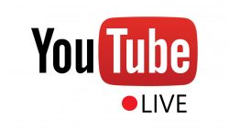
Dance case study: Royal Opera House – The Royal Ballet rehearses Arthur Pita’s The Wind (2017)
Case Study
Planning and partnerships:
Towards the end of a season, ROH select performances / rehearsals from the upcoming season that they want to live-stream.
Royal Opera House has the capacity to film in-house with 4 cameras. However, they use a specialist company, Jackshoot, to manage live-streaming. Jackshoot ensured that the broadcast of The Wind Ballet was streamed correctly, and offered technical support. Royal Opera House also employ freelance camera operators to assist with filming.
Live-streaming rehearsals is a good opportunity for in-house talent to begin to learn to film and direct so it’s a great career development opportunity
We use a few freelancers for live-streaming because we don’t do enough live-streaming to justify full-time staff with specialist skills in all areas
- Tony Followell, Head of Broadcast and Distribution
Lead time: 6 months
Cost
Under
£3.5k
This is the cost for all of the external support ROH used; freelance staff assisting with filming during the performance and Jackshoot.
Distribution channels:
Key take outs and implications for organisations:
Supplementing in-house capabilities: ROH recommends working with small to medium, or local, filming and broadcasting companies who can facilitate live-streaming for relatively low cost
Live streams can drive ticket sales: They found that live-streaming rehearsals from new ballets / operas can raise awareness of the real-world performance in advance and help drive ticket sales
Live-to-digital doesn’t need to be complex: ROH have filmed past rehearsals and behind the scenes content on iPhone cameras and streamed the footage on Facebook Live
Live streamed on Royal Opera House’s YouTube channel
Marketing: The live-stream was promoted in marketing materials including the bi-monthly ROH magazine as well as via their social media channels.
YouTube itself promoted the live-stream by notifying subscribers about new uploads by ROH.

Slide 55
What are the key barriers to creating live-to-digital and how have they been overcome?

Slide 56
Cost and lack of staff time are significant barriers to producing live-to-digital for most organisations
Key barriers and how they are overcome
Barriers to producing live to digital content
Doing live-to-digital often requires investment, which in the context of shrinking budgets can be hard to prioritise
Among those who produced live-to-digital in 2016/17
Among those who haven’t produced live-to-digital
lack of funds/ costs too much
Lack of staff time
Lacking in the brand power to make it financially viable
Lack of internal expertise
Rights clearance
Lack of creative interest
Lack of support from senior leadership
Does not fit with our mission
Lack of interest from our audience
Live-to-digital can represent a considerable time commitment and often comes under the remit of staff who are already overstretched
Rights clearance from artists can be an issue with the costs involved sometimes making live-to-digital untenable
Significant barrier
Slight barrier
Source: B2B survey administered by MTM. Q26. To what extent are each of the following barriers you have faced when producing live-to-digital work? Base: Organisations who have produced live-to-digital content in 2016/17 (n=128-136). Q37. To what extent are each of the following barriers that have prevented you from producing live-to-digital content in 2016 or 2017? Base: Organisations who have not produced live-to-digital content in 2016/17 (n=67-72)

Slide 57
Greater understanding of live-to-digital and its benefits would increase the propensity to undertake it
Key barriers and how they are overcome
Factors which would increase likelihood of producing live-to-digital content amongst organisations which did not undertake live-to-digital in 2016/17
Better understanding of the platforms available to publish and distribute work on
Three of the top four factors which would increase likelihood of live-to digital production involve better understanding of its practicalities, benefits and opportunities
Development of less expensive technology for producing and distributing live-to-digital
Greater clarity on the benefits live-to-digital can bring
Better understanding of what the opportunities are within your art form
Artistic staff becoming interested in live-to-digital for its creative potential
Development of better technology for producing and distributing live-to-digital productions
Improved processes for clearing rights
Live to digital is completely uncharted territory for [us] so all or any information about the process would be valuable
- Music Organisation
Improved ability to clear 'downstream' rights (beyond the live/encore broadcast)
Greater interest from senior leadership
Source: B2B survey conducted by MTM. Q43: Would any of the factors below make your organisation more likely to produce live-to-digital work in the future? Base: Organisations who have not produced Live-to-Digital content in 2016/17 (n=73)

Slide 58
Two thirds of organisations have worked with partners to produce content – mostly producers, followed by venues
Key barriers and how they are overcome
Types of organisations partnered with
65%
of organisations who undertook live-to-digital in 2016/17 have partnered with another organisation to produce live to digital content
Source: B2B survey administered by MTM. Q12: Have you partnered with any of the following types of organisations in 2016 or 2017 to support your production and distribution of live-to-digital content? Base: Organisations that produced live-to-digital content in 2016/17 (n=138)

Slide 59
Visual arts case study: BALTIC – Google gallery tour (2017)
Case Study
BALTIC is a centre for contemporary art located in Gateshead
Project context:
Having had an online video archive since 2003, BALTIC wanted to update their digital presence. After a number of conversations with Google, they collaborated with Google Arts & Culture to create a ‘Google street view’ of all four floors of the BALTIC gallery.
Four installations from their Artists’ Award Exhibition (a biennial prize presented to four emerging artists who have been selected by a panel of leading figures in contemporary art) were featured.
Providing this 360 access to the galleries means those who cannot visit for whatever reason can see them whilst extending the life of a temporary exhibition. Our only overheads were investing staff time
- Craig Astley, Head of Communications
Objectives:
Reach: to broaden reach to those less engaged in the arts or those who are unable to physically visit the exhibitions due to geography, cost or accessibility
Brand building: To build recognition of what BALTIC does and showcase the work of contemporary artists
Longevity: To extend the life of BALTIC’s exhibitions, given that the physical exhibitions change throughout the year
Archiving: to build up a digital archive of artworks
Impact:
Given the success of this project, BALTIC are incorporating live-to-digital more fundamentally into their way of working with contemporary artists

Slide 60
Visual arts case study: BALTIC – Google gallery tour (2017)
Case Study
Planning and partnerships:
BALTIC and Google Arts & Culture had discussions over several years before agreeing the nature of their collaboration.
Google provided staff to do the filming as well as the specialist equipment needed to ensure it was of sufficient quality to be used as ‘Google street view’ footage. Equipment included cameras and a roller track. The filming was completed in a single shoot between 5 and 10am. Two members of BALTIC staff assisted with the filming.
Live-to-digital is easier said than done in contemporary art because the artists are all living so it’s really important to discuss the rights as early as possible.
Live-to-digital is now being built into our ongoing agreements with artists. We mention at the outset that 360 video and live-streaming is part of our audience engagement. It’s important to get buy-in from the artists at the start
- Craig Astley, Head of Communications
Lead time: A few months, following a period of exploratory discussions
Cost
Absorbed by Google
The project and marketing for it was entirely funded by Google but BALTIC contributed staff time
Distribution channels:
Key take outs and implications for organisations:
Partnerships can facilitate live-to-digital: Collaborating with Google meant that BALTIC’s exhibitions were featured on a global platform free of charge
Rights issues: It is essential to gain artist buy-in with regard to rights at the outset of a project
Live-to-digital can champion emerging artists: Digital platforms can give additional exposure to emerging artists
Archiving: Live-to-digital allows BALTIC to have a lasting record of its exhibitions in an accessible format
Google Arts & Culture website
Marketing: Google ran a launch event to promote the tool with 10 partner arts organisations.
The marketing was primarily digital; Google provided BALTIC with promotional videos which they disseminated through their mailing list, social media channels and partner organisations.

Slide 61
The most common reason for partnering is to reach new audiences, followed by access to skills and equipment
Key barriers and how they are overcome
What have you gained from working with other organisations?
The desire to reach new audiences is the number one reason to collaborate with other organisations. Examples of this from our interviews include BALTIC Centre for Contemporary Art working with Google Arts and Culture to create a 360 degree gallery tour of their Artist Awards Exhibition, Glyndebourne’s partnership with the Telegraph Media Group to live stream the opera Hamlet on their site and Kaleider who worked with The Sydney Opera House to live stream their ‘showgame’, The Money, via the Opera House’s Facebook page. In all of these instances, partnerships extended reach considerably.
Use of skills and equipment/venue space can also be important, particularly when it comes to large scale live-to-digital. Ex Cathedra live streamed their Shakespeare Ode performance by working in conjunction with BBC Arts and CVAN East Midlands streamed their Make.Practice.Perfect. Event by working with the contemporary art magazine This is Tomorrow. In both of these cases the partner organisations provided all the technical skills and equipment necessary to realise these projects.
Source: B2B survey administered by MTM Q13: What, if anything, have you gained through partnerships with other organisations? Base: those who have produced live-to-digital in 2016/17 and have partnered with other organisation(s) to do so (n=91)

Slide 62
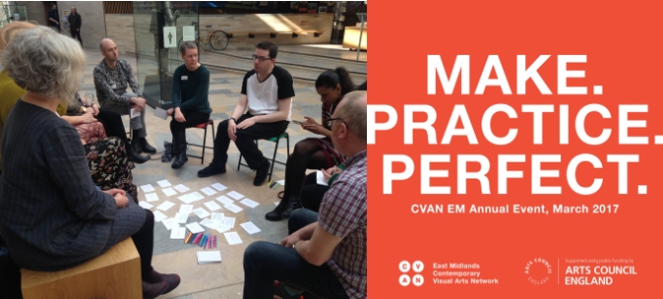
Visual arts case study: CVAN EM – Make.Practice.Perfect live stream (2017)
Case Study
CVAN EM is a professional network dedicated to strengthening the visual arts in the East Midlands. It develops sector specific programmes to support visual artists and arts organisations in the region and is part of the national CVAN (Contemporary Visual Arts Network)
Project context:
As part of their Arts Council funding, CVAN EM runs an annual, ticketed event. In 2017 the event was Make.Practice.Perfect which focused on how artists make art and the challenges of maintaining an art practice. The event featured a Q&A, panel discussions and breakout sessions.
Following feedback from the previous year’s event, CVAN EM felt it was important to broaden their audience and so decided to live stream the 2017 event.
For a specialised member of staff from this is tomorrow to attend and broadcast this day-long event, we paid a fee of £365.
- Elizabeth Hawley-Lingham, Director
Objectives:
Reach: to reach a larger, and more diverse, audience
Archiving: to create a digital record of the event which would be available on the CVAN EM website. The website is their main communication tool so it is important to them to be able to showcase their projects
Impact:
Live-streaming the event tripled the total live audience and thus exceeded the audience for the previous year’s event
The success of the live stream has encouraged CVAN EM to consider another live-to-digital project this year.
Key stats
130 people viewed the event on this is tomorrow’s website, tripling the total audience size (60 people attended the live event). It has since been viewed 100 times on YouTube

Slide 63
Visual arts case study: CVAN EM – Make.Practice.Perfect live stream (2017)
Case Study
Planning and partnerships:
CVAN EM co-produced this event with The Collection (a museum and art gallery in Lincoln) which was its host) and liaised with this is tomorrow (a contemporary art magazine) to enable the broadcast. The Collection made their auditorium available for the event free of charge.
CVAN collaborated with this is tomorrow who recorded and live-streamed the event on their website for a small fee.
Following feedback and review of the previous annual event, we felt it was important to try and broaden the audience. That’s why for Make.Practice.Perfect we worked with this is tomorrow to broadcast the event so we could try and reach a broader audience on the day but also after the event
Another objective was to produce some content which would showcase the project online because our website is really our key communication tool
- Elizabeth Hawley-Lingham, Director
Lead time: 3 months
Cost
This was the fee charged by this is tomorrow for filming the event and for one camera operator to attend the event
£365
Distribution channels:
Key take outs and implications for organisations:
Live streams can extend the lifespan of an event: By live-streaming the Make.Practice.Perfect event CVAN EM created a lasting online legacy of the live event itself. The footage is now available to future audiences on YouTube
Outsourcing live-streaming capabilities: Arts organisations with limited in-house capability can work with companies who manage the whole process; including filming and broadcasting. This does not necessarily have to be expensive, as shown by CVAN EM’s partnership with this is tomorrow
Live streamed on the this is tomorrow website
Marketing: The event was promoted through digital and printed posters and on the CVAN EM website through a pop-up and blog posts. It was also marketed through social media posts and an e-newsletter.

Slide 64
Many organisations sit at either end of the scale: they have full capacity for internal production or none at all
Key barriers and how they are overcome
How live-to-digital content is produced
We rely on external support for this almost entirely
34%
49%
In house with very little external support
We have the skills in house but we need to hire in the equipment
4%
13%
We have the equipment but need to supplement our staff
For more elaborate live-to-digital, such as event cinema or higher quality online streaming, arts organisations rely more heavily on external support and are often using specialist suppliers to film, produce and edit.
Lower-tech forms of live-to-digital e.g. Facebook Live can often be done in-house with very little external support as organisations tend to have the skills and equipment necessary to do this more basic live streaming.
Source: B2B survey conducted by MTM. Q11: Which of these options best describes the way you produce most of your live-to-digital content? Base: Organisations who have produced live-to-digital content in 2016/17 (n=138)
Notes:
Image credits:
Tate Shots: https://www.youtube.com/watch?v=bHtXBZ-6yRw
Royal Opera House Cinema season: http://www.roh.org.uk/news/royal-opera-house-live-cinema-season-201718

Slide 65
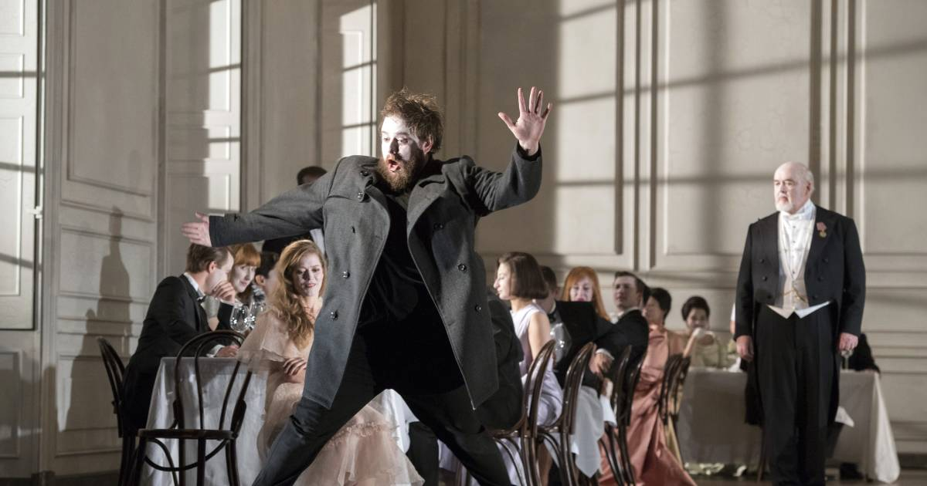
Opera case study: Glyndebourne – Hamlet (2017)
Case Study
Glyndebourne is an opera house in East Sussex. It has hosted an annual Glyndebourne Festival since 1934, provides an annual Tour and runs a year round Education programme. It is at the forefront of digital capture, making its work available to as broad an audience as possible.
Project context:
In 2017 Glyndebourne staged the world premiere of Brett Dean’s opera, Hamlet, as part of its Festival. The opera was included in Glyndebourne’s Summer screening season and the stage version toured the UK. As part of this, the opera was live broadcast on The Telegraph website and in cinemas. It was also available to watch ‘on-demand’ online in partnership with The Telegraph and on international VOD platforms. The opera was later licensed to the BBC and shown on BBC Four as part of its opera season in Autumn 2017.
​© Glyndebourne Productions Ltd. Photo: Richard Hubert Smith
The initial conversation started 5 years’ ago, and that was primarily about the new commission, casting and programming it onstage. As soon as we are contemplating a new production we also evaluate digital opportunities to broaden reach.
- George Bruell, Director of Communications
Objectives:
Reach: to extend reach further than those who are able to see the world premiere run (given the limited capacity of touring venues)
Brand building: to showcase that Glyndebourne attains the highest production values
Education: to produce a piece of work which can be used to promote opera e.g. including clips in online digital guides given to schools
Revenue generation: to recoup the financial cost of producing the digital versions of Hamlet
Impact
The viewing figures for the live-stream of Hamlet were on a par with those for more traditional, well-known operas.
Each Glyndebourne performance accommodates 1200 people; cinema, online, television and on-demand all outstrip that by several multiples
- George Bruell, Director of Communications

Slide 66
Opera case study: Glyndebourne – Hamlet (2017)
Case Study
Planning and partnerships:
Work to commission the world premiere and staging of Hamlet began 5 years previously when at the very beginning of the process the live-streaming options were considered. There were multiple planning stages including budgetary discussions, production planning and artistic planning.
For the filming and broadcast of Hamlet, Glyndebourne worked with a number of production & distribution partners. They used eight operated cameras and multi-track sound recording, hiring in specialist freelance staff including satellite and sound engineers.
For a work of this scale we hire up to 60 freelance staff like vision, audio and broadcast engineers and producers to work with our in-house team. We also hire specialist technical & satellite equipment including a fully equipped outside broadcast facility.
Our partnerships rely on working with partners who not only deliver the operational expertise but they also know their audience extremely well
- George Bruell, Director of Communications
Lead time: 1 year of preparation for the live stream
Cost
The project was funded by a combination of co-production contributions, license opportunities and sponsors and donors
Distribution channels:
Key take outs and implications for organisations:
Rights: Glyndebourne prioritises having extensive rights which allows much more flexibility to distribute the project
Live-to-digital should be complementary: Digital strategies should complement an arts organisation’s core skills and business priorities and not act as a distraction
Distribution partners: Partners can significantly extend reach
Risk: There are risks in undertaking large-scale live-to-digital projects so organisations must be confident of being able to recoup the cost
Shown live online for free with The Telegraph and international VOD platforms
Shown on BBC Four, iPlayer and international TV platforms
Shown in cinemas across the UK
Marketing: Glyndebourne used a combination of their own marketing channels and also worked with relevant distributors and their channels to promote the project

Slide 67
Whether they had produced live-to-digital work or not, organisations said they would value more info & training
Key barriers and how they are overcome
Support that would help organisations to produce live-to-digital content
Funding specifically aimed at live-to-digital productions
Information and guidance on the opportunities that exist within your specific art form
Increased collaboration between organisations
Information about the benefits live-to-digital can bring to an organisation such as yours
Targeted training in video/ audio production
Training in distribution/ marketing of live-to-digital
Industry events/ conferences/ workshops on live-to-digital
If/when we choose to go in this direction we would seek out the expertise and training we need… It would be useful to have the necessary resources available
- Dance Organisation
Source: B2B survey conducted by MTM. Q28: Which, if any, of the following do you think would be helpful in supporting organisations like yours to produce live-to-digital content? Base: Organisations who have produced live-to-digital content in 2016/17 (n=138) Q40: Which, if any, of the following do you think would be helpful to support organisations like yours to produce live-to-digital content? Base: Organisations who have not produced live-to-digital content in 2016/17 (n=73)

Slide 68
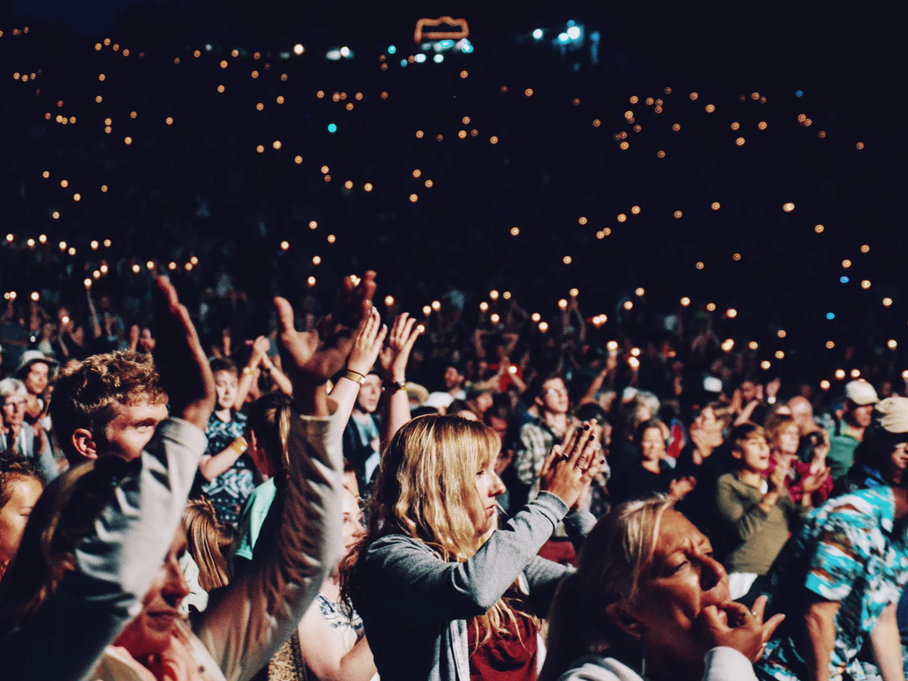
4. Who is the audience for live-to-digital and what impact is it having on them?
Method & objectives
Executive summary
What live-to-digital is being created?
Who is the audience for live-to-digital, and what impact is it having on them?
The future – where next for live-to-digital?

Slide 69
The data in the following section comes from three separate sources
Who is the audience?
1
2
Nationally representative survey
Arts engaged audience survey
A 15 minute online survey completed by 1,005 participants.
Quotas were set to ensure the sample was representative of all adults in England in terms of gender, age, region, socio-economic status, and household composition.
A 5 minute online survey, containing a subset of key questions from the nationally representative survey, completed by 360 participants.
The survey was distributed by arts and culture organisations, e.g. in newsletters/ social media posts.
No quotas were applied and due to this distribution method, while results are not ‘representative’, they aim to provide an indication of how an already arts-engaged audience would feel about the topics.
65% of this sample engage with live-to-digital arts & cultural content at least once every 6 months, equating to 649 respondents.
82% of this sample engage with live-to-digital at least once every 6 months – equating to 295 respondents.
3
4 x 2-hour discussion groups
4 x 2-hour discussion groups (2 in Brighton and 2 in Sheffield) with an arts engaged live-to-digital audience
The majority of data in this section is sourced from the nationally representative survey, as this is more robust in terms of sample size, and more likely to reflect a more broadly accurate picture of arts engaged audiences, due to a formal sampling procedure.
Data sourced from the arts engaged survey is indicated by a dotted light green box

Slide 70
Who is consuming live-to-digital and what are they consuming?

Slide 71
Our national survey suggests live-to-digital is consumed more than ‘real world’ arts and culture
Who is the audience?
33% of respondents engage with ‘real world’ arts and culture at least once a month, while 46% claim to engage with live-to-digital work at least once a month.
In this survey, those consuming ‘real world’ arts and culture are demographically similar to those consuming live-to-digital:
Demographics: Monthly consumers of ‘real world’ arts vs monthly consumers of live-to-digital
Gender
Age
Local environment
Social grade
Note that the profile of those engaged with live arts monthly is different from that typically seen in the DCMS Taking Part survey (owing to methodological differences).
Source: Nationally representative survey conducted by MTM. S1: Do you identity as…? S2: Please type in your age. S3b: Would you describe where you live as…? S6: Which of these best described the occupation of the main income earner within your household? Base: All adults (1,005) Monthly consumers of live arts/culture (n=329) Monthly consumers of live-to-digital (n=466). Dotted line = all adults in the population

Slide 72
Both ‘real world’ and live-to-digital arts consumers are typically most likely to be in Greater London
Who is the audience?
…However the proportion of live-to-digital consumers from outside of London is higher than the proportion of ‘real world’ consumers from outside London. This implies an important potential for live-to-digital to help democratise access to high quality live culture
Demographics: Monthly consumers of live arts vs monthly consumers of live-to-digital
Source: Nationally representative survey conducted by MTM. S3a: Where do you live? Base: All adults (1,005) Monthly consumers of ‘real world’ arts/culture (n=329) Monthly consumers of live-to-digital (n=466)

Slide 73
A fifth of adults claim to access live-to-digital monthly despite not attending any ‘real world’ arts & culture events
Who is the audience?
Overlap between attendance at ‘real world’ arts events and live-to-digital
Access live-to-digital monthly
Total: 46%
Attend ‘real world’ events monthly
Total: 33%
7%
26%
20%
Source: Nationally representative survey conducted by MTM. B2: How often do you do the following? [attendance at ‘real world’ events]. C1: How often do you typically engage with (watch, listen to or interact with) the following? C2: And how often, if at all, do you typically engage with live-to-digital, as described above, for each of the following art forms? Base: All adults (n=1,005)

Slide 74
Music was the most common form of live-to-digital content, with over a third of all adults engaging monthly
Who is the audience?
The frequency of engagement with music can be explained by the the popularity and prevalence of live music content, particularly of festivals on TV e.g. Glastonbury or live radio broadcasts
Frequency of engaging with live-to-digital content by art form
I like to watch Glastonbury on the TV. Now I’ve got kids I can’t make it there but it’s a good substitute. Me and my husband will sit there with a glass of wine
- Discussion group participant: 18-29, Sheffield
Music
Museums
Literature
Dance
Visual arts
Combined arts
Opera
Monthly use among arts-engaged survey respondents:
35%
10%
14%
13%
17%
8%
8%
Source 1: Nationally representative survey conducted by MTM. C2: And how often, if at all, do you typically engage with live-to-digital, as described above, for each of the following art forms? Base: Adults 16+ (n=1005). Source 2: Arts Engaged survey conducted by MTM. Q6.And how often, if at all, do you typically engage with live-to-digital content, as described above, for each of the following art forms? Base: all respondents (n=360)

Slide 75
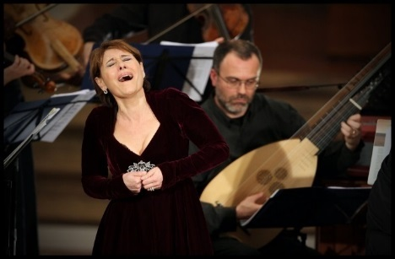
Music, literature and opera are more commonly consumed in live-to-digital form than ‘real-world’ form*
Who is the audience?
Engagement with art forms: At least once every 6 months
Music
Museums
Literature
Dance
Visual arts
Combined arts
Opera
*Music, literature and opera are more commonly consumed in live-to-digital form than ‘real-world’ form when you look at it on both a monthly and 6 monthly basis. If you look at 'ever’, literature and opera are more commonly consumed in live-to-digital form than ‘real-world’, but 77% have ‘ever’ engaged with music in the 'real world' compared to 72% who have ‘ever’ for live-to-digital music content. For the purpose of this report, ‘real world’ engagement with ‘literature’ was defined as ‘attend a literature or poetry performance’
Source: Nationally representative survey conducted by MTM. B2: How often do you do the following? C2: And how often, if at all, do you typically engage with live-to-digital, as described above, for each of the following art forms? Base: Adults 16+ (n=1005)
Notes:
Image credit:
Roundhouse Poetry Slam final: https://www.youtube.com/watch?v=3k8qf5FZIOs
Glastonbury coverage by BBC: https://ichef.bbci.co.uk/images/ic/976x549_b/p02vnt7v.jpg

Slide 76
Performance events are the most commonly engaged with type of live-to-digital
Who is the audience?
Frequency of engaging with types of live-to-digital content
Video / audio of parts of performances / events
Live streamed whole performances / events
Events / talks associated with artworks, performances, exhibitions or collections
Artistic / cultural works that use live-to-digital as part of their core concept
Recorded whole performances / events
Digital versions of installations / exhibitions
Source 1: Nationally representative survey conducted by MTM. C1: Below is a list of things we consider in our definition of live-to-digital arts or cultural content. How often, if at all, do you typically engage with (watch, listen to or interact with) the following? Base: Adults 16+ (n=1005) Source 2: Arts Engaged survey conducted by MTM. Q5.Below is a list of things we consider in our definition of live-to-digital. How often, if at all, do you typically engage with (watch, listen to or interact with) the following? Base: all respondents (n=360)

Slide 77
The difference in accessing long and short form content is relatively modest – there is significant usage of both
What are they consuming, why and how frequently?
Frequency of using live-to-digital by duration of content
Source: Nationally representative survey conducted by MTM. C3: How often do you consume live-to-digital arts or cultural content that lasts for the following durations? Base: Live-to-digital consumers (n=649)

Slide 78
Facebook and YouTube are key channels for reaching, audiences
What are they consuming, why and how frequently?
Places where people are likely to come across/engage with live-to-digital content
There is considerable passive consumption of live-to-digital with people encountering performances or events through friends’ posts on Facebook or algorithmic recommendations on YouTube
Those under the age of 34 are more likely to discover and engage with live-to-digital on social media and YouTube
I’ve watched some poetry slams before. If they appear I’ll click on them. They’ll appear on YouTube because it goes hand in hand with a lot of rap music
- Discussion group participant: 18-29, Brighton
(an online ad, an ad in a magazine, an ad on the radio)
Source: Nationally representative survey conducted by MTM. G2a: In which of the following places would you be likely to see or hear information about a piece of live-to-digital content? G2b: And in which of the following places would you be most likely to engage with (watch, listen to or interact with) live-to-digital content if you were to come across it? Base: Adults 16+ (n=1005). *There is not 100% overlap between those likely to come across in locations & engage in the same locations
Notes:
% likely to engage in location among those likely to come across live to digital in same location:
Facebook: 64%
Advertising: 37%
YouTube: 62%
Arts organisation website: 34%
Friend / colleague: 43%
Newsletter: 39%
Poster outside venue: 28%
Twitter: 44%
Instagram: 54%
Snapchat: 33%

Slide 79
Social media can be a key means of live-to-digital discovery and developing artistic practice
What are they consuming, why and how frequently?
In our discussion groups participants mentioned stumbling upon live-to-digital content on YouTube and Facebook which has fired their passion for an artform; in particular dance, visual arts and spoken word
This content was generally not actively sought out but consumed through the news feed on Facebook or recommendations on YouTube
Participants who were practicing artists tended to be more active in their live-to-digital consumption e.g. following dance companies or visual artists on Instagram
Participants mentioned following choreographers and ballet troupes such as Ballet Boyz on Instagram to gain access to behind the scenes footage of rehearsals in order to develop their own practice
Social media was viewed as an ideal means of sharing short videos with other arts engaged friends
Participants also mentioned that their children who were interested in dance or visual arts would seek out performers or artists online to learn from them e.g. Twisted Poets
My daughter is obsessed with Twisted Poets and she’ll sit on YouTube on the iPad and watch videos of them. We share an iPad so I have to wrestle it off her sometimes - Discussion group participant: 45-64, Sheffield
From a dancer's point of view, there's a lot of famous dance choreographers now that film in their own dance studios when they're doing classes. They tend to record parts of the dance and post it on Instagram, Facebook and Twitter. Then you can follow or learn it. It gives you inspiration of what dances to do and it’s nice to see rehearsals too
- Discussion group participant: 18-24, Sheffield
My daughter watches a lot of artists online because she wants to be an artist. She logs into online workshops and uploads live time lapses of herself painting on Instagram
- Discussion group participant: 45-64, Sheffield

Slide 80
Short-form content is consumed on smartphones but larger-screens are important for longer-form
What are they consuming, why and how frequently?
Devices used to access live-to-digital content
I wouldn’t be interested in watching opera on a small screen because I lose the experience. If it’s big I sit there and I feel part of it, it becomes an event
- Discussion group participant: 45-64, Brighton
Discussion group participants said short form content was generally consumed on smartphones, with snippets of performances or events being viewed through social media. For full longer-form performances larger screens were preferred to create a more immersive audio-visual experience. This was particularly the case with the performing arts, with opera in the cinema being a prime example
I follow Ballet Boyz on Instagram and they post clips of them live on stage each night
- Discussion group participant: 18-29, Sheffield
Source: Nationally representative survey conducted by MTM. C4a: Do you typically access live-to-digital arts or cultural content via or at the following? C4b: And which of these do you typically use to access live-to-digital content most often? Base: Live-to-digital consumers (n=649)

Slide 81
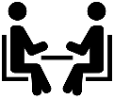
More people tend to engage with live-to-digital content when they are at home on their own
What are they consuming, why and how frequently?
When do people typically engage with live-to-digital?
I project everything I watch in the comfort of my living room. The Opera Platform gives you all of the European Opera Houses. Digital Concert Hall is the Berlin Philharmonic and they stream live.
- Discussion group participant: 45-64, Brighton
Source: Nationally representative survey conducted by MTM. C5: When do you typically engage with live-to-digital arts content? Base: Live-to-digital consumers (n=649)

Slide 82
Convenience and affordable access are the most common motivations for consuming live-to-digital
What are they consuming, why and how frequently?
Reasons for engaging with live-to-digital arts and cultural content
From arts engaged survey:
25%
21%
56%
44%
27%
38%
37%
63%
40%
24%
13%
21%
21%
12%
Key:
Convenience
Access
Trial
Live-to-digital experience offered more than the real-world experience
Passion
Only a small minority say that live-to-digital content offers more than the real-world experience
Source 1: Nationally representative survey conducted by MTM. D3: Which of the following are reasons why you have engaged with live-to-digital arts content? D4: And which is the main reason you have engaged with live-to-digital arts content? Base: Live-to-digital consumers (n=649). Source 2: Arts Engaged survey conducted by MTM. Q8. Which of the following are reasons why you have engaged with live-to-digital arts or cultural content? Base: all respondents (n=360)

Slide 83
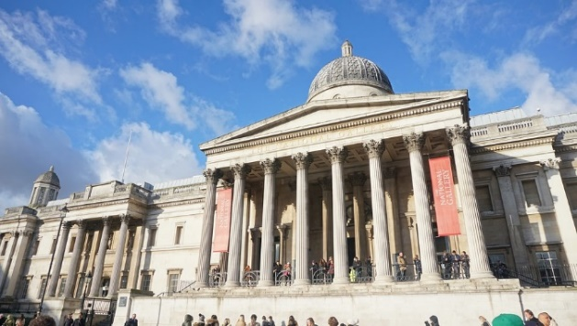
Live-to-digital also allows you to trial an arts performance or event before committing to attending the real thing
What are they consuming, why and how frequently?
I prefer to go to specific live performances of these when it particularly interests me. There are some things that I really don’t know much about and maybe live-to-digital would be a good first introduction to these, without having to travel and waste time and money on something you find you hate!
- 65+, East of England
The most common reason for consuming live-to-digital is that it allows you to engage with content at a time and place that suits you
A close second to this, is that it broadens access, allowing audiences unable to attend because of time, geography, price or ticket limitations to experience a version of the ‘real life’ performance or event
Live-to-digital also offers a low-cost, low-risk means of trialling a piece of artistic or cultural work before you commit to attending the real thing
I can start watching something on digital and if I am enjoying it I'll watch to the end. If I've no idea what the topic is supposed to be showing I can take a look to find out. Plus with digital forms, I can find comments on it to get a better idea as to what I can expect. Going to a live event could result in paying for the ticket to something I reluctantly sit through just because I paid.
-55-64, North West
Source: Expert interviews conducted by MTM
Notes:
Image credit:
British Museum – Living with Gods Exhibition Tour https://www.youtube.com/watch?v=Ek-TCEP7w90

Slide 84
56% of consumers said live-to-digital had encouraged them to engage with organisations they wouldn’t have otherwise
What are they consuming, why and how frequently?
72%
of arts-engaged survey respondents agreed that the availability of live-to-digital content could encourage them to experience new art forms or culture, or to engage with new arts and cultural organisations they wouldn’t have otherwise
Live-to-digital consumers
Non live-to-digital consumers
“The availability of live-to-digital content has encouraged me to…
“I would be open to engaging with live-to-digital content…
…experience new art forms or culture I wouldn’t have otherwise”
…engage with new arts or cultural organisations I wouldn’t have otherwise”
…for art forms and culture I don’t normally engage with”
…from arts and cultural organisations I don’t normally engage with”
17%
Said they would be open to engaging with live-to-digital for new
art forms or culture
or
organisations
that they don’t normally engage with
Strongly agree
56%
Had either engaged with new
art forms or culture
or
organisations
that they wouldn’t have otherwise
Agree
Neither agree nor disagree
Disagree
Strongly disagree
Source 1: Nationally representative survey conducted by MTM. D5. To what extent do you agree or disagree with the following statements? Base: Live-to-digital consumers (n=649) Non live-to-digital customers (n=356). Source 2: Arts Engaged survey conducted by MTM. Q7. To what extent do you agree or disagree with the following statements? Base: all respondents (n=360)

Slide 85
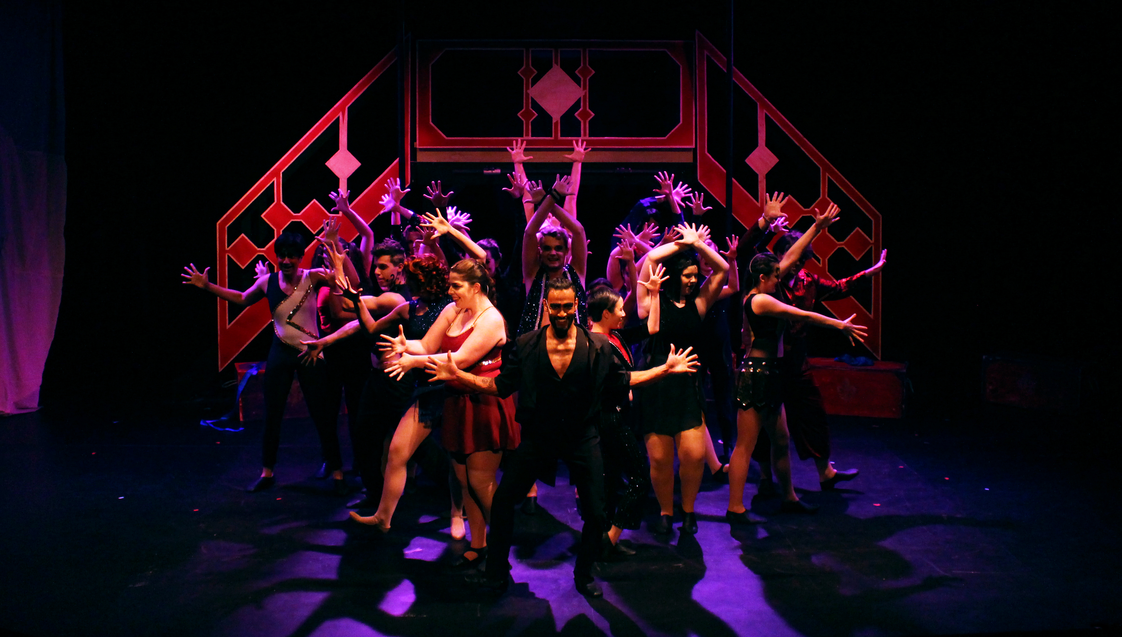
Participants in the discussion groups also highlighted live-to-digital’s potential to engage them in new artforms
What are they consuming, why and how frequently?
Prior to the session, we invited participants to watch a piece of live-to-digital in an artform they wouldn’t ordinarily engage with
Many participants were surprised how much they enjoyed the live-to-digital they watched and claimed they would continue to consume content related to the artform
I picked the Wolf Works one. It said it’s a ballet but it’s like a contemporary ballet, it’s different. I don’t understand dance because I can’t dance, but you watch it and just lose yourself. I’m in awe of people that can dance professionally, I just think they’re amazing
-Discussion Group Participant: 45-64, Sheffield
I watched the Royal Opera House opera on YouTube, and I actually sat and watched it for an hour and half last night and I got right into it. I didn’t want to turn off. I wanted to know what happened at the end. I thought it was really interesting
-Discussion Group Participant: 18-29, Sheffield
I thought [the Hockney 360 experience] was very interesting. I’d not really thought about going to see the exhibition but having seen the taster it inspired me to want to go
-Discussion Group Participant: 45-64, Sheffield

Slide 86
Almost three in ten of our arts engaged audience seemed unsure where to look for live-to-digital content
How does live-to-digital compare to the live experience?
For each ‘barrier’ we asked about in our survey, only a minority of arts engaged audiences considered each a potential barrier to engagement. In 10 out of 13 cases, over 75% did not perceive these as main barriers.
Barriers to engaging with live-to-digital amongst an arts engaged audience
Source: Arts Engaged survey conducted by MTM. Q9. Which of the following are the main things which might prevent you from engaging with live-to-digital arts content? Base: all respondents(n=360)

Slide 87
How does the live-to-digital experience compare to the ‘real world’ one?

Slide 88
People still tend to prefer the ‘real world’ experience to the live-to-digital one
How does live-to-digital compare to the live experience?
Level of agreement/ disagreement with:
“Live-to-digital is a valuable replication of the ‘real world’ experience but will never be able to compete with the ‘real world’ experience”
People prefer the ‘real world’ artistic experience to the live-to-digital one
That said, live-to-digital was generally viewed as a valuable alternative
Strongly agree
58%
Agree
overall
When you’re at something live, you feel like the artist is performing to you. If you’re behind a screen you lose that and the social aspect a little bit
- 18-29, Sheffield
Agree
Neither agree nor disagree
71%
Of arts-engaged survey respondents agree
It's difficult to replace the live. With the TV you can have full surround sound, six speakers in your lounge but it's still not the same as actually being there.
- 45-64, Brighton
Disagree
Strongly disagree
1%
Source 1: Nationally representative survey conducted by MTM. E2/D5: To what extent do you agree or disagree with the following statements? Base: Live-to-digital consumers (n=649). Source 2: Arts Engaged survey conducted by MTM. Q7. To what extent do you agree or disagree with the following statements? Base: all respondents (n=360)

Slide 89
Only a minority of those interested in each art form would rule out live-to-digital content – and some now prefer it
How does live-to-digital compare to the live experience?
Preference for ‘real world’ vs live-to-digital by artform
Source: Nationally representative survey conducted by MTM. F1: Now please think about each of the following art forms/ types of cultural experience. Which best describes your feelings about how the ‘real-world’ experience compares to live-to-digital content for each? Base: Those interested in each art form. Museums (n=480) Music (n=755) Theatre (n=448) Dance (n=262) Visual arts (n=207) Opera (n=126) Literature (n=403) Combined arts (n=113)

Slide 90
Opinions were divided on the importance of the ‘live-ness’ of the live-to-digital experience
How does live-to-digital compare to the live experience?
“Live-to-digital content would only be of interest if it was streamed live rather than recorded live but watched/ listened to later”
Some favour the “rare”, “special” and “authentic” aspects of the live experience
Others feel the convenience of being able to watch a recorded performance as and when you want is preferable to live
It was also noted that it might vary according to art form e.g. music might benefit from not being live if the final output was of a higher quality and that for museums or visual arts the liveness was fairly inconsequential
Strongly agree
35%
Agreed they would only be interested in live streamed content
Agree
Neither agree nor disagree
The live version makes me feel like I belong there and feel the same as the people who are physically there
- 18-24, Greater London
The live experience adds to the authenticity of some forms of media, others, it isn’t quite as big of a deal
- 35-44, Yorkshire
56%
Of arts-engaged survey respondents disagree
Disagree
Strongly disagree
Source 1: Nationally representative survey conducted by MTM. D5: To what extent do you agree or disagree with the following statements? Base: Live-to-digital consumers (n=649). Source 2: Arts Engaged survey conducted by MTM. Q7. To what extent do you agree or disagree with the following statements? Base: all respondents (n=360)

Slide 91
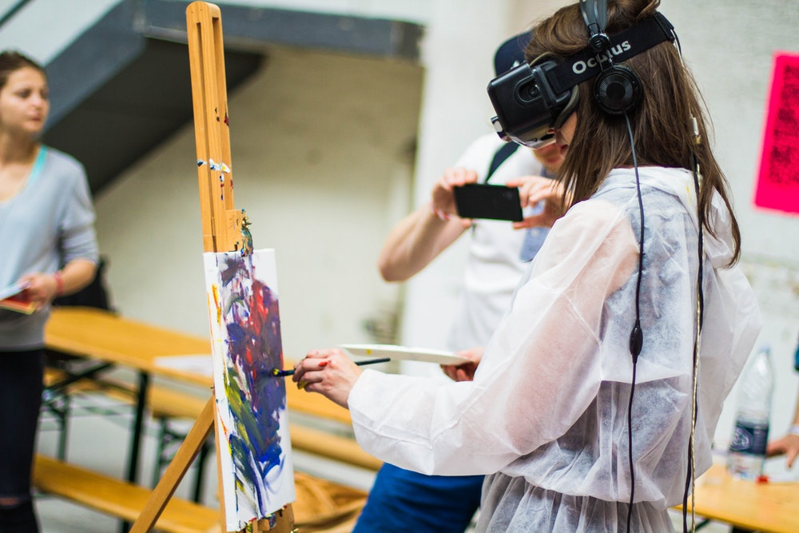
5. The future – where next for live-to-digital?

Slide 92
What role will live-to-digital have for arts organisations in the future?

Slide 93
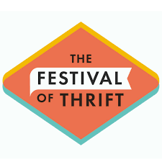
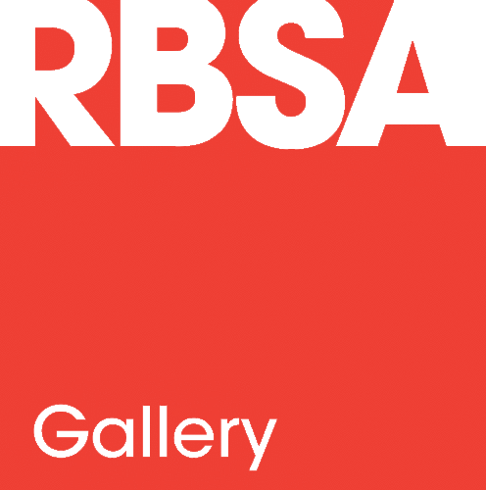
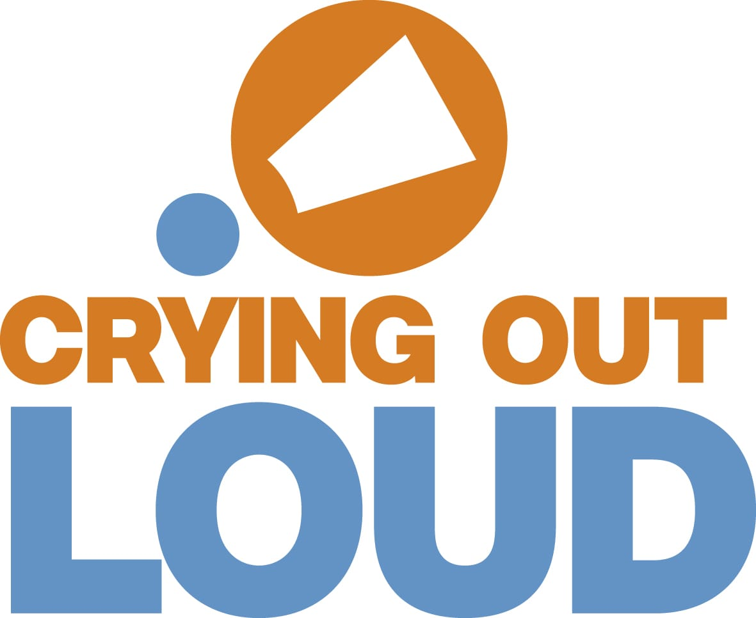
A substantial majority of those who did not produce live-to-digital in 2016/17 would be interested to do so in future
The role of live-to-digital in the future
Organisations who did not produce live-to-digital: future plans
Currently working on, or planning, live-to-digital content in the near future
83% would like to produce live-to-digital in the future
Interested in producing live-to-digital, but uncertain what this could look like
Would like to produce live-to-digital, but does not seem feasible at our organisation
NB: the organisations above are examples of those who expressed interest in doing live-to-digital in the future
No plans or interest in producing live-to-digital
Source: B2B survey conducted by MTM. Q47: Which of these best describes your organisation’s plans/ feelings towards producing live-to-digital content in the future? Base: Organisations who have not produced live-to-digital content in 2016/17 (n=73)

Slide 94
Across all live-to-digital formats, there was an appetite for producing more rather than less in the coming years
The role of live-to-digital in the future
Expected change in type of live-to-digital produced over the next few years
Live streamed whole performances / events
Video / audio of parts of performances / events
Artistic / cultural works that use live-to-digital as part of their core concept
Events / talks associated with artworks, performances, exhibitions or collections
Recorded whole performances / events
Digital versions of installations / exhibitions
Whilst an upward trajectory is clearly predicted for performances, events and talks, a significant minority of organisations who are currently creating digital versions of exhibitions and works that use digital as part of their core concept expect to do less.
Source: B2B survey conducted by MTM. Q29: We’d like to know how you expect your live-to-digital activities to change over the next few years. Going forward, do you expect to be producing more or less live-to-digital content? Base: Organisations who have produced live-to-digital content in 2016/2017 (n=138)

Slide 95
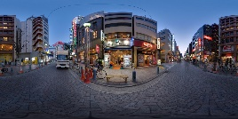
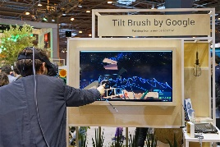
Augmented and Virtual Reality were seen as offering the potential for more immersive live-to-digital experiences
The role of live-to-digital in the future
Formats of live-to-digital organisations would like to produce in future
Expert interviewees saw VR and AR as facilitating a more immersive and involving live-to-digital experience, whether that’s the VR film Future Aleppo, which imagines one boy’s dream for a reconstructed Syrian city of Aleppo, or Google’s Tilt Brush, which lets you paint in 3D space with VR.
In time we’d like to start doing VR and AR but we’re not doing it at the moment
-Opera organisation
Recall from earlier slide: formats of live-to-digital produced in 2016/17:
Source: B2B survey conducted by MTM. Q31: And which formats would you produce live-to-digital content in, if you were able to overcome any barriers you currently face? Base: Organisations who have produced live-to-digital content in 2016/17 (n=138) Q51: And in which formats would you produce live-to-digital content, if you could? Base: Organisations who have not produced any live-to-digital content in 2016/17 (n=73)

Slide 96
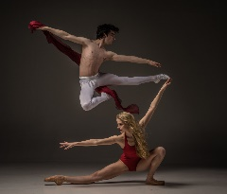
The organisations we interviewed also identified a variety of other potential live-to-digital growth areas
The role of live-to-digital in the future
Interactive artworks: live-to-digital has the potential to facilitate a different viewing experience; one in which, through social media and other online platforms, the viewer ceases to be passive and is able to participate in and even shape the outcome of an artwork
The low-fi stuff on Facebook and YouTube is most interesting. It gets great engagement and generates significant interest
- Museum
Image by Brian Slater, courtesy of FACT.
Artists driving the content: a transition from live-to-digital being led by the marketing department in arts organisations to being more firmly embedded in the practice of artists and the artistic team is also predicted by some
I think live-to-digital will be more artist driven in the future instead of being a preserve of the marketing department
- Festival
The partnership space: partnerships between arts organisations, producers and distributors are seen as important to enable arts organisations to create ambitious interdisciplinary live-to-digital programmes by pooling time, resources and experience
One of the strategic imperatives of the BBC is to role out live [BBC technology] so partners can make use of technology independently
- Broadcaster
Education: live-to-digital is also seen as an exciting means of opening up historical sites and museum collections to a wider audience through 360 degree tours and Facebook and YouTube Live tours; it’s felt the demand for this content will only grow
Learners around the world want to gain access to cultural institutions and live-to-digital has the potential to facilitate this live
- Museum
Source: Expert interviews conducted by MTM.
Notes:
Image credits:
FACT Touch My Soul
Georgina Starr - Androgynous Egg (http://georginastarr.com/Androgynous-egg-video-georgina-starr.htm)

Slide 97
What do audiences want and expect from live-to-digital in the future?

Slide 98
There is a clear appetite to consume live-to-digital in the future, although a fifth of people expect never to engage
The role of live-to-digital in the future
Expected frequency of engaging with live-to-digital content in the future
6-monthly users of live-to-digital
All
I think [live-to-digital] completely extends the boundaries of art… In future I think the [digital] experience will just become an aspect of the wider, cultural experience
- 46-54, Brighton
Source: Nationally representative survey conducted by MTM. G3. How frequently, if at all, do you expect you will engage with live-to-digital content in the future? Base: Adults 16+ (n=1005)

Slide 99
Users and non-users are most interested in whole live-to-digital performances, either live or recorded
The role of live-to-digital in the future
%% Interested overall
Interest in different types of live-to-digital content in the future
Somewhat interested
73%
78%
Very interested
72%
63%
63%
61%
61%
56%
57%
48%
43%
47%
NET interest among arts-engaged survey respondents:
85%
84%
69%
58%
62%
74%
*those who use live-to-digital at least once in 6 months
Source 1: Nationally representative survey conducted by MTM. G1a. How interested would you be to engage with the following types of live-to-digital content in the future? Base: Adults 16+ (n=1005) Those who use live-to-digital at least one every 6 months (n=649) Source 2: Arts Engaged survey conducted by MTM. Q10. How interested would you be in watching/ listening to/ interacting with the following types of live-to-digital content in the future? Base: all respondents (n=360)

Slide 100
Music, museums and dance seem to be the most eagerly anticipated artforms when it comes to live-to-digital
The role of live-to-digital in the future
Interest in different types of live-to-digital by artform in the future
%% Interested overall
Somewhat interested
83%
Very interested
68%
65%
59%
57%
52%
46%
52%
48%
43%
40%
43%
36%
33%
*those who use live-to-digital at least once in 6 months
Source: Nationally representative survey conducted by MTM. G1b. And how interested would you be in engaging with live-to-digital content within each of the following art forms? Base: Adults 16+ (n=1005) Those who use live-to-digital at least one every 6 months (n=649)

Slide 101
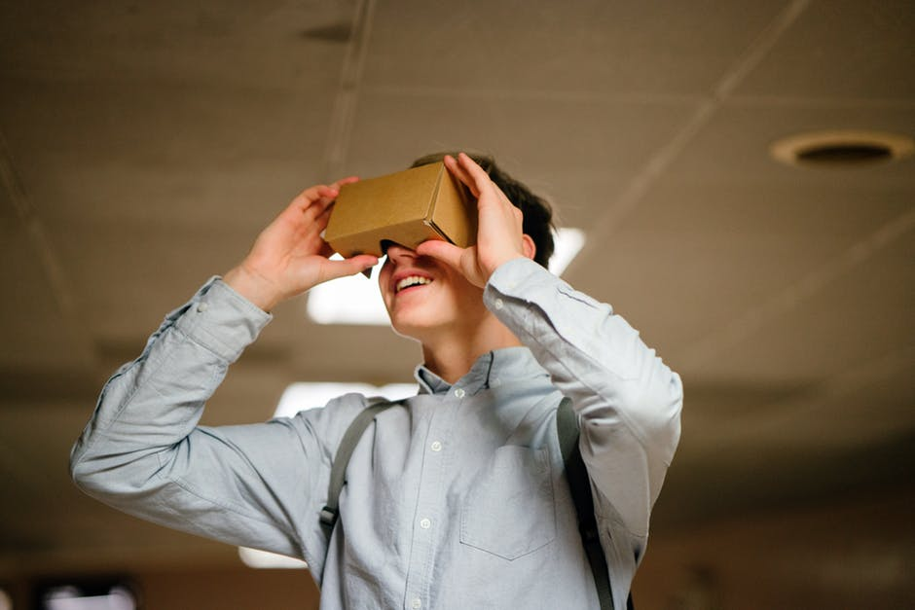
VR was seen as creating a more immersive but potentially isolating live-to-digital experience
The role of live-to-digital in the future
The more we push VR, the more immersive it will become; the more the digital experience will come close to ‘liveness’
- 45-64, Brighton
I think if VR tech takes off more, I feel more people could be swayed to digital.
- 18-29, Sheffield
The way technology is going at the moment the immersion is in isolation. All this stuff with the virtual reality, it's not the shared space, it's you and you alone. With live, you're with other living human beings. Immersion takes you so far, but what it negates is the human side
- 45-64, Brighton
Participants in our discussion groups frequently mentioned the potential of virtual reality to create a more immersive live-to-digital experience, in which the distinction between a ‘real world’ experience and a ‘live-to-digital’ one diminishes
That said, both younger and older age groups expressed concern that virtual reality, with its individual headsets, might lead to solitary artistic experiences in which the social aspect of attending ‘real world’ events is lost
I think VR would be of interest, but at the same time it does upset me a little bit because you’re viewing it in isolation and it takes you away from the present moment
- 18-29, Brighton
Source: Consumer focus groups conducted by MTM

Slide 102
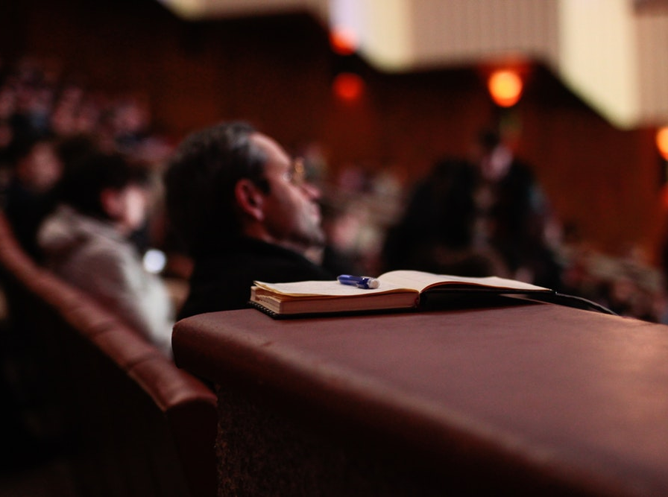
6. Key take outs for arts organisations

Slide 103
Key take outs for arts organisations
Key take outs for arts organisations
1
Live-to-digital is a positive experience for arts organisations: almost all organisations surveyed who produced live-to-digital in 2016/17 said they would like to continue doing it and 99% of organisations view live-to-digital as having been a positive experience.
Organisations view live-to-digital as complementary to rather than cannibalising their ‘real-world’ offer: organisations do not see live-to-digital as having an adverse effect on audience attendance of their ‘real-world’ events. Instead, they see it as a means of building interest and driving attendance.
Live-to-digital offers the potential to reach audiences who cannot consume an organisation’s ‘real-world’ offer: Live-to-digital broadens access, allowing audiences unable to attend because of time, geography, price or ticket limitations to experience a version of the ‘real-world’ performance or event.
Live-to-digital introduces audiences to artforms and organisations they haven’t encountered previously: over half of respondents to our nationally representative survey who consume live-to-digital have engaged with new artforms or organisations that they wouldn’t have otherwise as a result of their live-to-digital consumption.
Live-to-digital can be a distinct experience in its own right, not just a replication of the ‘real-world’ experience: across artforms, organisations were preoccupied with creating compelling standalone digital experiences which offered clear ‘added value’, whether that’s a Facebook Live gallery tour in which the works you see are further illuminated by expert commentary (which is unavailable at the ‘real-world’ exhibition); an opera and dance live streamed in cinemas, in which you may get better and more varied views of the performers than you could hope to achieve attending the venue in person; or being able to influence the outcome of an artwork directly through social media
2
3
4
5

Slide 104
Key take outs for arts organisations
Key take outs for arts organisations
Planning is essential, even for small-scale live-to-digital: thinking about every stage of the live-to-digital process in advance, from rehearsing and filming to marketing and distribution is key. Rehearsing the event, checking the equipment including sound quality, assessing the integrity of the live stream and priming audiences with the date and time of broadcast are all integral components of successful live-to-digital.
Partnerships are key to overcoming the barriers to live-to-digital, which include cost and lack of staff time: two thirds of those surveyed who undertook live-to-digital in 2016/17 have worked with partners (primarily producers, followed by venues) to produce live-to-digital content before. They cite reaching new audiences, followed by skills and equipment as the key reasons for doing so
Free platforms like Facebook and YouTube and inexpensive equipment are lowering the barriers to entry: online platforms like Facebook and YouTube and equipment like the Mevo camera offer a low-risk, low-cost means of arts organisations undertaking live-to-digital.
Facebook and YouTube are key channels for live-to-digital consumption: Facebook and YouTube are two places where audiences tell us they come across live-to-digital. Our research revealed considerable passive consumption of live-to-digital through these platforms and as a result, positive potential for extending reach.
There is clear appetite amongst organisations to try technology which creates a more immersive live-to-digital experience including VR, AR and 360-degree video: 50% of organisations surveyed who had not undertaken live-to-digital in 2016/17 would like to produce 360- degree video, 38% virtual reality and 38% augmented reality. Expert interviewees saw VR and AR as facilitating a more immersive and involving live-to-digital experience. However, some audience members noted that VR could be socially isolating.
6
7
8
9
10

Slide 105
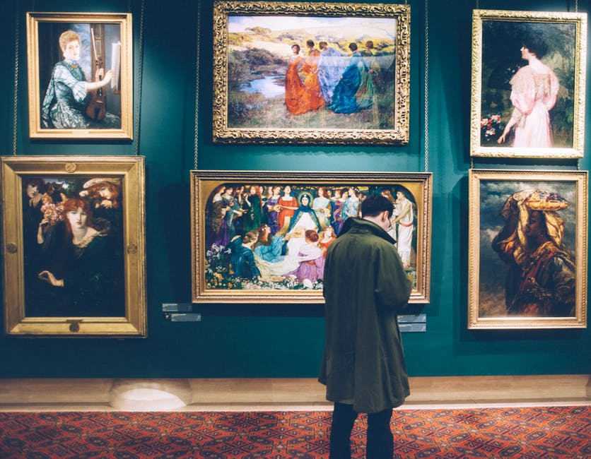
7. What does this research add to the overall picture of live to digital in the arts in England?

Slide 106
Comparisons with AEA’s 2016 research into Live to Digital in the theatre sector : Organisations
Overall picture of live to digital in the arts
AEA findings | MTM findings
Economics incentivised live-to-digital production for a significant minority of organisations… Among theatre organisations, generating new income was the least common motivation for live-to-digital work (22% said it very strongly motivated production, 11% say ‘fairly strongly’) | Across other arts and culture sectors, generating revenue was not a significant driver of live-to-digital production Only 7% of organisation who completed our survey said revenue generation was a reason they produced live-to-digital, and only 1% said it was the main reason they did so.
… but it also often deterred it Cost was the most commonly identified barrier to adoption (66% of respondents) | Cost is perceived as a barrier across art forms and cultural organisations… 49% of organisations who had produced live-to-digital content said lack of funds was a significant barrier they had faced, while 68% of those who had not produced live-to-digital content cited lack of funds as a significant barrier preventing them from doing so in 2016/17 …however, live-to-digital production need not be as expensive as it is perceived to be We spoke to organisations who had produced content relatively inexpensively, for example The British Museum might spend as little as £300 to do a Facebook Live gallery tour
Breaking down perceived barriers to entry through capacity building could promote wider participation among suppliers AEA identified a ‘compelling need for on-going, sign-posted training in creating, producing, funding and distributing live-to-digital theatre’ | The following were identified as things that would be helpful to support organisations to produce live-to-digital content: Information and guidance on opportunities that exist within each art form (identified as helpful by 56% of organisations who have produced live-to-digital work and 62% of those who had not) Information about the benefits live-to-digital can bring to an organisation (48% and 53% respectively) Targeting training in video/audio production (54% and 45% respectively) Training in distribution/marketing of live-to-digital work (58% and 42%)

Slide 107
Comparison with AEA: Audiences
Overall picture of live to digital in the arts
AEA theatre findings | MTM rest of sector findings
Audiences do not believe live-to-digital is a substitute for live-theatre; they believe it is a significant and distinct experience 77% of audience members who streamed digital content said that it was ‘a very different experience’ from live attendance. 36% of those who had not watched a streamed theatre performance stated that a preference for live theatre was a reason why. | We also found live-to-digital is not thought of as a substitute for ‘real world’ arts and culture 58% of live-to-digital users said live-to-digital was ‘a valuable replication but would never compete with live’. 43% said the fact that the atmosphere is not the same as the ’real world’ experience is a barrier to consumption, and 32% said the fact that it is ‘less of a collective experience without an audience’ might prevent them from engaging with live-to-digital arts & cultural content. A preference for ‘real world’ was seen strongly for museums and galleries, perhaps influencing this stronger result.
Motivations for audiences to access live-to-digital theatre streams include: Access at times when the live performance is not available (48%) Avoiding costs associated with going to a venue (38%) Cheaper ticket costs (33%) Saving time (31%) Because a live performance was sold out (31%) | Motivations for engaging with live-to-digital across art forms include Access at a time that suits me (22%) Real-world event/exhibition was too expensive (20%) Live-to-digital version was free (25%) Live performance was sold out (10%)
Consumers are motivated by live-to-digital’s economics and convenience, but not it’s ‘liveness’ 9% of theatre streamers said live-ness was ‘very important’ and 20% said it was ‘somewhat important’ | Our findings were broadly similar on the importance of ‘liveness’. 11% strongly agree and 24% somewhat agree that ‘Live-to-digital content would only be of interest if it was streamed live rather than recorded live and watched/listened to later’
Poor technology and low awareness of available content are barriers to streaming live-to-digital theatre A lack of understanding of what content is available (43%) and how one can access it (34%) has put many off streaming. | Barriers to arts-engaged audiences engaging with live-to-digital content across art forms include Being unsure where to look for live-to-digital content (28%) Not having come across any (11%) Not being able to find any live-to-digital content related to their interests (11%)

Slide 108
Contact
Richard Ellis
Partner
Richard.ellis@mtmlondon.com
Matthew Macaulay
Associate Director
Matthew.macaulay@mtmlondon.com

Slide 109
Appendix: more on the research process

Slide 110
We also conducted expert interviews with 21 arts and culture organisations
Appendix
What? 21 telephone interviews with a range of arts and culture organisations across art forms
Why? to gain in depth insights into live-to-digital practice, including that of a number of key organisations across artforms
List of organisations interviewed:
Abdandon Normal Devices
BALTIC
BBC Arts
Bristol Culture
CVAN EM
Event Cinema Association
Ex Cathedra
FACT
Glyndebourne
Green Rock
Kaleider
Manchester International Festival
Random International
Roundhouse
Royal Opera House
Sadler’s Wells
Sky Arts
Sound & Music
Tyne & Wear Archives & Museums
Tate
The Space

Slide 111
Through our supply-side survey, we heard from over 200 organisations about their experience of live-to-digital
Appendix
What? Online survey of arts and culture organisations, sampled from the Digital Culture Survey participant set
Why? to gather quantitative measures from a broad range of arts organisations
Input gathered from 211 organisations
138 had produced some type of live-to-digital content in 2016/17
73 had not produced any live to digital content

Slide 112
We undertook 4 x 2-hour discussion groups with current live-to-digital consumers
Appendix
What? 4 x 2-hour discussion groups (2 in Brighton and 2 in Sheffield) with an arts engaged live-to-digital audience
Why? to gain a clear understanding of views, expectations and experiences of live-to-digital amongst an arts engaged audience
What? 4 x 2-hour discussion groups (2 in Brighton and 2 in Sheffield) with an arts engaged live-to-digital audience
Why? to gain a clear understanding of views, expectations and experiences of live-to-digital amongst an arts engaged audience
Group 1
Group 2
Group 3
Group 4
Brighton
Brighton
Sheffield
Sheffield
8 x 45-64
8 x 18-29
8 x 45-64
8 x 18-29
Detail
Even gender split across each group
All participants were passionate about at least one art form, with an interest in a mix of art forms achieved across the groups
All were arts engaged and had visited at least one live cultural event / performance in the past 6 months.
Half of the groups had a greater interest in real-word art, whilst the other half were more engaged in live-to-digital art

Slide 113
We conducted surveys among the end consumers to understand demand for and use of live to digital
Appendix
What? Online surveys of a nationally representative sample, and also of current arts engaged audiences
Why? To validate qualitative findings, and help to scale findings up to the wider population
Nationally representative survey
Arts engaged audience survey
15 minute survey, issued online to a representative sample of adults ages 16+ in England. n=1,005
5 minute survey, distributed by arts and culture organisations to their contacts. n=360
16-34
34%
16-34
22%
50%
Urban
68%
30%
Urban
69%
35-54
36%
35-54
36%
50%
55+
30%
Rural
28%
70%
43%
Rural
30%
55+

Slide 114
A methodological note on Opera
Appendix
From our nationally representative survey, we noted a relatively high interest in Opera as an art form. From our representative sample:
10% claimed to go to see an opera (in ‘real life’) on a monthly basis, 18% say they do so at least once every 6 months and 42% have ever gone to see opera
13% said that they engage with live-to-digital opera on a monthly basis, 19% said at least every 6 months, and 38% said have ever gone to see opera
For comparison, in 2016 AEA‘s report the Arts Council found that:
27% had attended a live opera in the last 12 months
28% of respondents had attended an Event Cinema screening of an Opera performance
19% had seen an Opera online or on the television
Thus, our figures, while feeling intuitively high, are more or less in line with those published previously. However – we would like to suggest some factors which may be influencing these scores (detailed opposite).
Recalling frequencies of behaviours is difficult, particularly over longer durations of time (e.g. once every 6 months). Further, it is known that survey respondents are likely to overinflate their interests when answering a questionnaire – particularly when the subject implies high levels of social capital (such as, arguably, interest and involvement in high-brow cultural pursuits). This bias, of course, would be present across all arts forms, so comparing differences between art forms is likely to be more ‘accurate’ than considering the actual values themselves in isolation.
Another thing that may influence the figures for live-to-digital opera is the popularisation of opera-type content in recent years, e.g. Paul Potts and Susan Boyle on Britain’s Got Talent, ‘Popera’ band G4 on the X Factor, and regular TV appearances from mezzo-soprano Katherine Jenkins. These may have been considered ‘live to digital opera content’ by respondents, who perhaps have engaged with these types of clips rather than full opera performances.

