Slide 1
Transforming Governance Programme
v

Slide 2
About Cause4
About Cause4
Cause4 is a social business and B-Corporation, specialising in advice, fundraising, training and programme development. Led by Michelle Wright, we have extensive expertise in governance and in-depth knowledge of ACE’s National Portfolio requirements. Our three core programmes are the Trustee Leadership Programme, Arts Fundraising & Philanthropy and Heritage Compass.
Transforming Governance
Delivered in partnership with Arts Council England, Transforming Governance will strengthen governance by focussing on effective leadership, strategy, recruitment and implementing the Investment Principles (IPs).

Slide 3
Transforming Governance: Workshop Outline
Workshop Structure
Each workshop will be delivered via Zoom, lasting 90 minutes (50 minutes content, 15 minutes guest speaker, 15 minutes breakout task and a 10-minute break). There are seven workshops in total.
Workshop 1a: Overview of Governance for Charity Trustees
Workshop 1b: Overview of Governance for Non-Charities
Workshop 2: Leading and Overseeing Strategy
Workshop 3: Governance and the ACE Investment Principles
Workshop 4: Developing Inclusivity and Relevance
Workshop 5: Recruitment of Trustees and Succession Planning
Workshop 6: Working with a Board

Slide 4
Workshop 2: Working with a Board: Making the most of your Board or Oversight Group
v

Slide 5
Working with a Board
Developing your understanding of governance, board responsibilities and working together successfully.
Getting the best out of your board
Effective board and staff collaboration
Developing a positive organisational culture
Overcoming relational challenges

Slide 6
Arts Council England – Board Requirements
“Given the scale of public funding we are putting into the National Portfolio, it is especially important we are confident that we are investing in ‘well run’ organisations.”
For ACE, one of the characteristics of a ‘well run’ organisation is that it has a board or oversight group that is independent of the executive and can take responsibility for ensuring the efficient and effective delivery.
For organisations without a traditional governance structure, ACE requires that some form of ‘Oversight Group’ is formed – this could be a small advisory group; steering committee, or sub-committee.

Slide 7
Arts Council England – Minimum Requirements
Whatever its form, the oversight group must have the following minimum responsibilities and authority:
To be independent of the executive leadership of the national portfolio organisation
To have - in either direct or delegated form - responsibility for oversight of the Arts Council national portfolio funding agreement
To meet regularly (at least four times a year) with the executive leadership in order to review progress on the national portfolio funding agreement
To receive and review regular reports on progress against the funding agreement and ensure that those reports are forwarded to the Arts Council on a timely basis
To meet and communicate directly with the Arts Council, independent of the executive if required

Slide 8
Achieving balance between Boards and Executive

Slide 9
Dissonance
“My Trustees frustrate the hell out of me, we put in a huge effort into producing our board papers and I seriously wonder if they even read them, they are second guessing me and my team on a continuous basis, they haven’t a strategic bone in their bodies and to be quite honest, other than their oversight role, I seriously question if they add any value to me, my team and this organisation.”
Boards are often seen as a ‘necessary evil’ or a thing ‘to be managed’ and executive teams have low expectations of their effectiveness.
“I want to be helpful but I have no idea how, the Executive team don’t seem to understand the role of boards, we get a long list of achievements from them but no real idea of what would make a difference, or what support they really need.”

Slide 10
What causes tension between Board and Executive?
Unclear expectations of the relationship
A breakdown in communication
A lack of trust
A lack of support and/or scrutiny
Trying to do each others’ roles
A lack of clarity of each others’ roles and responsibilities
Not anticipating issues or making difficult decisions too late
Not sharing information
Not involving each other enough in crucial decisions
An indecisive Board – makes it impossible for an Executive Team to move forward and implement change

Slide 11
The fundamental responsibilities are different
Board | Executive
Being true to the governing document | Realisation of business plan/strategy
Public benefit and core purpose | Delivery of activities
Future sustainability
Board members' first and highest loyalty must be to the organisation and its purpose and sustainability. Not to the founder or leader.

Slide 12
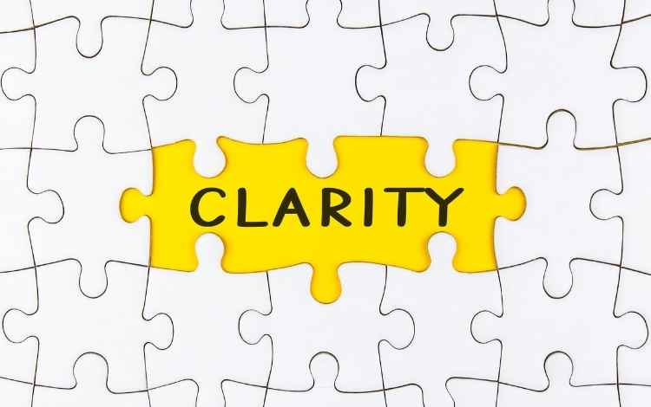
What do Executives want from the board? Is it clear?

Slide 13
Two way respect
Respect is the key foundation stone for the Executive team to demonstrate the highest levels of accountability to the board for their performance and their overall leadership day to day of the organisation.
And conversely for the Board to demonstrate to the team their support for the organisation, its role and its future sustainability.

Slide 14
Best Practice

Slide 15
Asset based board approach
Sometimes the best way to re-imagine the use of an asset is to think about it as your only asset. In the economic environment we find ourselves, we have to be innovative and creative and to make the most of what we do have.
How do we curate board process to bring the best out of this asset?

Slide 16
Types of Board Performance
Boards govern in three distinct modes. Each mode serves important purposes, and together, the three add up to governance as leadership.
Type I - Fiduciary or Operational Mode which oversees operations and ensures efficient and appropriate use of resources, legal compliance and fiscal accountability.
Type II - Strategic or Logical Mode. Here, the Board’s central purpose is to ensure a winning strategy for the organisation.
Type III - Generative or Expressive Mode and is a cognitive process for deciding what to pay attention to, what it means, and what to do about it - also a good definition of governance.
Governance as Leadership, (2005) Richard Chait, William Ryan & Barbara Taylor (BoardSource)

Slide 17
Why are we here?
“Why are we here?” When board members have minimal opportunity for meaningful input beyond basic legal and financial oversight and fundraising, they lose interest, pull away, and stop contributing energy, ideas and money.
This disinterest further drives the CEO to act alone, increasing possible dissonance.
Relations come down to thoughtful and inclusive planning processes and honest and ongoing communication of progress toward goals.
“You can’t build an airplane while you are flying.”

Slide 18
Strategy development
Who leads – Trustees or Executive?
An inclusive planning process is time-consuming and less efficient than some executives would like. But it is essential that it include board and staff members so there is real buy-in with their responsibilities. By helping to set the vision, board and staff members are eager to do their best work. Boards run well, bolster an organisation's revenues, provide access to influential figures, inspire confidence in stakeholders, help manage risks, improve leaders' performance.
“Too many charities only present a rosy picture to their board and sweep challenges under the rug.”

Slide 19
Types of Board Behaviour
Tick Box Board - This type of board approves whatever management proposes and often plays the role of cheerleader. These organisations tend to be run by charismatic chief executives who value their autonomy and assemble a board with the expectation that its members are compliant.
Micromanaging Board - This board takes on key management functions in addition to its proper governing role. The staff becomes disempowered and often passive (or passive-aggressive) in the face of repeated intrusions into what they rightfully expect would be their areas of authority.
Divided Board - These boards consist of people who are concerned about only one part of the organisation. They typically avoid trying to see how all the pieces of an organisation fit together, leaving that task solely to the chief executive. The fragmentation can be dangerous when an organisation's revenues shrink and priorities must be reevaluated quickly and holistically.

Slide 20
Delegated Authority
Governance
Board’s role
How Boards make decisions, allocate resources, achieve results, and are held accountable
Management
Executive function
Day to day management of tasks and details of running an organisation
The Board has established clear levels of delegated authority within which:
Some decisions are reserved to the board
The CEO is empowered to make decisions and delegate authority to the staff for the day-to-day operation of the charity
The CEO is required to escalate high risk and /or high impact issues for the timely attention and consideration of the board

Slide 21
Key differences between the roles of Board and Executive
Chairs - Governance | CEOs - Management
Lead Board members. Set vision, mission, and values. Shape strategy and monitor impact. Establish and monitor policies. Ensure financial viability. Ensure accountability. Select, line manage, & appraise the CEO. Manage Board risk and conflicts. Ensure legal compliance. Review governance effectiveness. Provide insight and judgement. | Lead staff and volunteers. Work within agreed mission, vision, and values. Propose strategy and report progress. Develop and ensure implementation of policies. Raise and spend resources. Report to stakeholders. Appoint and manage staff. Identify, evaluate and mitigate risk. Provide advice. Support effective governance. Provide evidence and analysis.
Keep each other informed of appropriate information and decisions. Provide leadership for the organisation, with respect to both internal and external affairs. Respect each other’s roles and responsibilities.
Notes:
http://www.associationofchairs.org.uk/wp-content/uploads/2014/10/AoC_ChairsCompass_final.pdf
http://www.pewtrusts.org/~/media/legacy/uploadedfiles/wwwpewtrustsorg/reports/pew_fund_for_hhs_in_phila/governance20as20leadership20summary20finalpdf.pdf
http://www.cloresocialleadership.org.uk/userfiles/documents/Research%20reports/2010/Research,%20Penelope%20Gibbs,%20FINAL.pdf
https://www.acevo.org.uk/governance/governance-faqs#relationshipwithchair
http://www.thinknpc.org/publications/happy-relations/
Not used
* https://charitycommission.blog.gov.uk/2016/05/20/how-will-the-new-charities-act-affect-your-charity/
**2016 changes to charity law - http://www.legislation.gov.uk/ukpga/2016/4/contents

Slide 22
Board/Executive relationship
“Chairs should be like good neighbours – you want to know they are there if you ever do run out of sugar, but not necessarily (have them) in your house all the time checking your stock of sugar”
Penelope Gibb Clore Social Leadership Programme
Effective Boards give:
Heathy Challenge
Support to implement
They need transparency, enable the board to review key documents so they have the full picture and can contribute effectively. A good balance is needed between too ‘cosy’ and too detached.

Slide 23
What do we mean by healthy challenge?
Healthy challenge provokes new thinking.
Unhealthy challenge is about needing to win.
Both formal and informal communication is essential to board and executive director cooperation.
Board meetings are the forum to report on programme progress, budgets and to make governance decisions.
Informal communication between board meetings amongst staff and board members is also critical. This builds trust. Staff members feel safe and can be frank about progress (or lack thereof) toward an objective. It also allows board members to become advocates and help offer solutions, find extra resources, and use their executive intellectual skills to move the agenda.
Notes:
http://www.cloresocialleadership.org.uk/userfiles/documents/Research%20reports/2010/Research,%20Penelope%20Gibbs,%20FINAL.pdf
https://www.thirdsector.co.uk/study-reveals-strains-charity-chair-chief-executive-relationships/governance/article/1104709
http://www.thirdsector.co.uk/leadership-governance-tensions-chief-chair/governance/article/1161226

Slide 24
What do we mean by healthy challenge?
Lack of diversity often compounds dysfunction. Homogeneity can lead to groupthink, and a board culture that alienates people who could otherwise help move the organisation forward. Ethnic, racial, and gender diversity are important, as well as diversity of wealth, professions, work style, expertise, political ideology, location, and religious faith.
Board performance and staff performance should be considered together.
Stifled Dissent can be dangerous. Minority views and scepticism should be welcomed around the board table, with all members encouraged to speak their minds and vote their consciences, even if this creates tension. Passionate debate and non-unanimous votes are a signal of a strong, not weak, governing body. Boards have a responsibility to lead the most effective decisions building consensus through group decision-making.
Notes:
http://www.cloresocialleadership.org.uk/userfiles/documents/Research%20reports/2010/Research,%20Penelope%20Gibbs,%20FINAL.pdf
https://www.thirdsector.co.uk/study-reveals-strains-charity-chair-chief-executive-relationships/governance/article/1104709
http://www.thirdsector.co.uk/leadership-governance-tensions-chief-chair/governance/article/1161226

Slide 25
What do we mean by healthy challenge?
Our role as partners is for Board and Executive to come up with the best decisions to protect the organisation’s sustainability.
Working collaboratively requires regular discussion, effort and flexibility.
Notes:
http://www.cloresocialleadership.org.uk/userfiles/documents/Research%20reports/2010/Research,%20Penelope%20Gibbs,%20FINAL.pdf
https://www.thirdsector.co.uk/study-reveals-strains-charity-chair-chief-executive-relationships/governance/article/1104709
http://www.thirdsector.co.uk/leadership-governance-tensions-chief-chair/governance/article/1161226

Slide 26
Knowledge and power asymmetries
The Board hold line management responsibilities for paid staff – however it is often not seen like this.
How do knowledge and power asymmetries present?
How we we prevent them?
How do we address them?
What do we do if there is a catastrophic breakdown between Chair and CEO?
Notes:
http://www.thinknpc.org/publications/happy-relations/

Slide 27
Conflict between Boards and Executive
Is it inevitable
Many say that there is a need for Boards to challenge Executive teams on their strategic ideas, behaviour and decisions, however challenge can lead to conflict and tension, some healthy, some destructive.
Its role in progress
The skill lies in challenging to improve performance and to ensure decisions are made on a sound basis, without creating an unhealthy working environment.
Effective communication, expectation management and role distinction between Boards and Executive is vital.
‘Not having any conflict is a problem; there needs to be a bit of conflict to indicate that challenge is happening.’
Penelope Gibbs, Director Transform Justice
Notes:
http://www.cloresocialleadership.org.uk/userfiles/documents/Research%20reports/2010/Research,%20Penelope%20Gibbs,%20FINAL.pdf
http://www.thinknpc.org/publications/happy-relations/

Slide 28
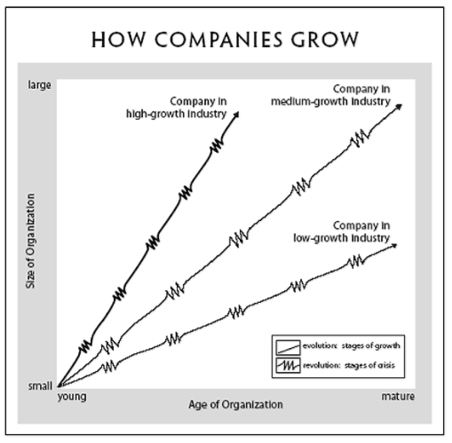
Conflict between CEOs and Chairs
Greiner argues that organisations have to go through phases of “revolution” which lead to “evolution” when growing from small young companies to larger older companies.
He outlines 5 key stages of growth, i.e. evolution:
Creativity,
Direction,
Delegation,
Coordination, and
Collaboration.
Notes:
https://hbr.org/1998/05/evolution-and-revolution-as-organizations-grow

Slide 29
Conflict between CEOs and Chairs
Each give way to crisis phases, i.e. phases of revolution:
Leadership,
Autonomy,
Control,
Red tape, and
A last as yet unknown one at time of print – the author speculated it would be the psychological saturation of employees who grow emotionally and physically exhausted from the intensity of teamwork and the heavy pressure for innovative solutions.
Notes:
https://hbr.org/1998/05/evolution-and-revolution-as-organizations-grow

Slide 30
Interactions between the Board and SMT
How does a Board work best with other members of the SMT?
Notes:
https://www.theguardian.com/voluntary-sector-network/2016/apr/19/charity-chief-executives-board-trustees - this seems to go against everything we say about clarity of roles and not doing each others’ jobs?
http://www.thinknpc.org/publications/happy-relations/ - I’ve added some of this into other sections as I think it’s more relevant, also not entirely sure what is meant here

Slide 31
Conflict resolution
What is the role of Chairs/Boards in adjudicating in disputes between other Trustees and Senior Management team members?
As the leader of the Board, if conflict arises within it, it would be the Chair’s role to handle the conflict and mediate if necessary.
Whether it is the Chair’s responsibility to resolve conflict within the senior management team will depend on the charity – the bigger the charity the likelier it is to have an HR procedure to deal with conflict.
Clear dispute and grievance procedures are important.
Notes:
https://www.theguardian.com/voluntary-sector-network/2013/may/31/how-find-right-chairperson-your-charity

Slide 32
Organisational Culture
Organisational culture includes an organisation's expectations, experiences, philosophy, and values that hold it together, and is expressed in its self-image, inner workings, interactions with the outside world, and future expectations. It is based on shared attitudes, beliefs, customs, and written and unwritten rules that have been developed over time and are considered valid. It’s shown in:
The ways the organisation conducts its business, treats its employees, customers, and the wider community,
The extent to which freedom is allowed in decision making, developing new ideas, and personal expression,
How power and information flow through its hierarchy, and
How committed employees are towards collective objectives.

Slide 33
What Counts?

Slide 34
Relational Challenges
What might cause the need to step in?
There has been a complaint
Someone's behaviour is causing challenges for others
There are consistent challenges that are prohibiting the organisation to move forward
There has been a failure of leadership
There are personal circumstances impacting individual members
An individual is facing harassment or bullying
An individual is not engaging at all

Slide 35
What If It Goes Wrong?
We may need to step in and focus on conflict resolution – at this stage, there are several options to consider:
- Informal: An informal conversation to attempt to resolve the issue
- Formal: Utilise the Code of Conduct to set out a formal approach and identify clear next steps should the issue not be resolved.
- External Support: Bring in an external mediator to step in and support conflict resolution.

Slide 36
Overcoming Relational Challenges
Policies and Processes are important to making sure a board is run well. What might we put in place?
An agreed code of conduct that sets out:
How the board will behave
What board members need and expect from each other
How differences will be handled
The shared responsibility of the board for creating the right atmosphere
The relationship between the board, staff, and volunteers and expected behaviours on all sides

Slide 37
Southwark Park Gallery – Code of Conduct
We exist to create an open, safe and respectful environment that is welcome to everyone; a place to connect and facilitate meaning through the experience of art, nature and culture.
To maintain this environment as a space for everyone to enjoy, we hereby outline our responsibilities as an organisation and those expectations we have for all who engage with us, our activities, and daily life in our park.
Our Code of Conduct provides everyone we engage with clear expectations of our collective behaviour, shared responsibilities, and best professional practice.
We ask that everyone observes this policy when visiting, representing, conducting business on behalf of, and working with us.
https://southwarkparkgalleries.org/wp-content/uploads/2023/09/Southwark-Park-Galleries-Code-of-Conduct-23-1.pdf

Slide 38
Break We will be back in 10 minutes
v

Slide 39
Discussion - how do we develop Culture within our Board and Executive teams?
Where have you seen great examples of good organisational culture?
How do Boards influence culture both positively and negatively?
What are some effective ways of improving organisational culture through the Board and Executive working together?
Post 2-3 summary points in the chat post session.

Slide 40
Transforming Governance Programme
v

