Slide 1
Transforming Governance Programme
v

Slide 2
About Cause4
About Cause4 Cause4 is a social business and B-Corporation, specialising in advice, fundraising, training and programme development. Led by Michelle Wright, we have extensive expertise in governance and in-depth knowledge of ACE’s National Portfolio requirements. Our three core programmes are the Trustee Leadership Programme, Arts Fundraising & Philanthropy and Heritage Compass.
Transforming Governance
Delivered in partnership with Arts Council England, Transforming Governance will strengthen governance by focussing on effective leadership, strategy, recruitment and implementing the Investment Principles (IPs).

Slide 3
Transforming Governance: Workshop Outline
Workshop Structure
Each workshop will be delivered via Zoom, lasting 90 minutes (50 minutes content, 15 minutes guest speaker, 15 minutes breakout task and 10-minute break). There are seven workshops in total.
Workshop 1a: Overview of Governance for Charity Trustees
Workshop 1b: Overview of Governance for Non-Charities
Workshop 2: Leading and Overseeing Strategy
Workshop 3: Governance and the ACE Investment Principles
Workshop 4: Developing Inclusivity and Relevance
Workshop 5: Recruitment of Trustees and Succession Planning
Workshop 6: Working with a Board

Slide 4
Workshop 3: Governance and the ACE Investment Principles
v

Slide 5
Governance and the ACE Investment Principles
Workshop 3: Governance and the ACE Investment Principles
This session focusses on the Ambition & Quality, Dynamism and Environmental Responsibility Investment Principles, and seeks to support boards to work with the Investment Principles as drivers of change.
Let’s Create Strategy
Overview of the Investment Principles
How the Investment Principles guide effective practice
How governance can best reflect the Investment Principles
Meeting ACE requirements in implementing the Investment Principles

Slide 6
GOVERNANCE AND THE INVESTMENT PRINCIPLES
Market Hall immersive dome © Jay Stone
Sheffield Theatres © Chris Saunders

Slide 7
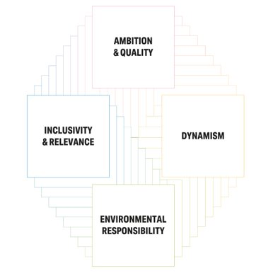
OUR INVESTMENT
PRINCIPLES
Ambition & Quality
Dynamism
Environmental Responsibility
Inclusivity & Relevance
We expect Boards to ensure these are embedded in the culture and operation of the organisation.

Slide 8
INVESTMENT PRINCIPLES SUPPORT ORGANISATIONS
The IPSOs focus on supporting other organisations and individuals in the cultural sector to embed one or more of our Investment Principles in their work.

Slide 9
ILLUMINATE - AUDIENCE INSIGHTS PLATFORM
Improved data culture
Audience development
Access valuable information
A free audience insights platform, utilising survey and box office data to provide meaningful analysis to support your audience development

Slide 10
MORE TOOLS AND RESOURCES
Impact & Insight Toolkit
Environmental Responsibility Programme
Digital Culture Network
> www.artscouncil.org.uk/NationalPortfolio23

Slide 11
WORKING TOGETHER: BOARDS
Boards to take an active role
Targets and success measures
Support and holding executive to account
Board papers:
Agenda
Minutes of the last meeting
Financial information
Risk register
Quarterly progress reports
Sheffield Theatres © Chris Saunders

Slide 12
QUARTERLY PROGRESS REPORTS
Ockham’s Razor © Mark Dawson
The Activity Plan
Contribute to Let’s Create Outcomes and their associated Elements
Investment Principles Plan
Planned
In progress
Established
>www.artscouncil.org.uk/NationalPortfolio23/key-information-2023-26-npos-and-ipsos
Sheffield Theatres © Chris Saunders

Slide 13
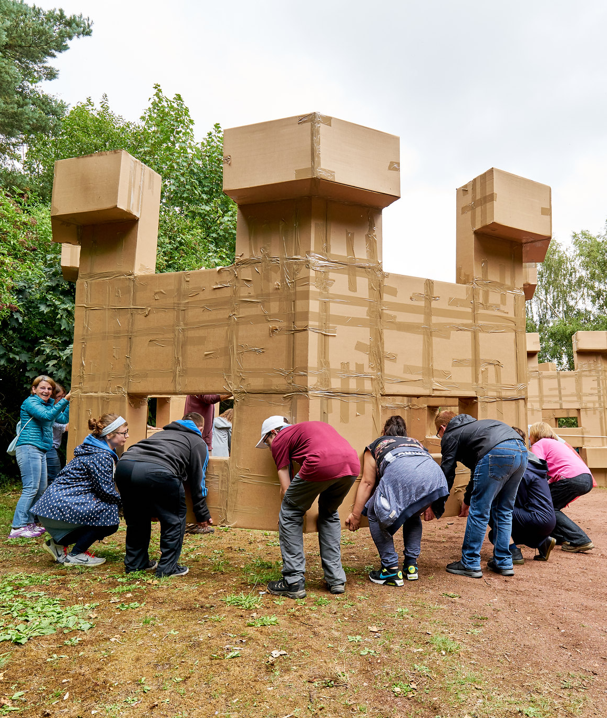
REPORTING AND YOUR ORGANISATION
Demonstrate the value that creativity and culture brings
Share progress and challenges
Arts Council templates are not mandatory - what works for your organisation?
Lost Castles. Artist: Olivier Grossetȇte © Rob Battersby
Sheffield Theatres © Chris Saunders

Slide 14
The Board’s Role
All NPO and IPSO boards/oversight groups should take an active role in ensuring that the Investment Principles are embedded in the culture and working practices of the organisation. Arts Council England has articulated some key areas that are important to ensuring that the Investment Principles are embedded and activated:
Scheduling board development days to focus on the Principles
Identifying how your board members’ skills and expertise can best support the embedding of the Principles
Assigning responsibility to relevant sub-committees or individuals
Ensuring that the Investment Principles are standing agenda items for board meetings

Slide 15
The Board’s Role continued
Arts Council England has articulated some actions that Boards or Oversight Groups could take to lead on the Investment Principles:
1. Identify where the skills and knowledge are on the board that could contribute to Implementing the Investment Principles and look out for the gaps, investing in skills development as needed.
Other Board members or leaders with knowledge of the Investment Principles from other NPOs can be helpful
Sharing and exchanging knowledge with other NPOs
Identifying skills gaps in oversight requirements, for example, financial knowledge (recruiting skills needed to meet the needs of the strategy)
2. Be clear who will lead different areas and how they will report back to the wider governance structure.
Having a Board sub-Committee to be able to give real time to investigating the Investment Principles
Having a lead Board member or members responsible for the Investment Principles
However, all Board members need to be aware of their responsibilities for the Investment Principles, as part of a team.

Slide 16
The Board’s Role continued
3. Set out and continually review the outcomes you want to achieve and take responsibility for holding the organisation to account.
Simple one page overview sheet referred to at each meeting – ensure this is part of a learning/improvement cycle where a transparent review of progress is regular and changes made to delivery as needed
Focus on Investment Principles that are your specialisms, weight time given to them accordingly
Proactive discussion with ACE if activities can’t be met or need to be amended/changed
Ensure processes are backed up by data, with clear records kept and systems improved upon
4. Agree as a group how this work will fit with your risk management and what the risks are to your organisation if you do not make progress.
Framing Investment Principles as part of risk oversight is useful, it can also help in guiding proactive conversations with ACE if activities are off track or need to be amended

Slide 17
The Board’s Role continued
5. Have a clear understanding of your organisation’s strategic plan, and its vision, mission and values.
Embedding the Investment Principles into the overall strategic plan can make the process feel more organic – Boards need to operate as both an accelerator and a brake, supporting the prioritisation and balancing of activities is essential
Continually reflect on and refine the business model of the organisation, meaning you can be responsive to the changing external environment and quick to respond to new opportunities
Pay attention to how you are spending time, if ACE represents 50% of your income the time spent will necessarily need to be different to if ACE income represents 5%
Discuss adaptation of templates etc with ACE

Slide 18
Evaluating the IPs
The Centre for Cultural Value has embedded an evaluation model based on the following principles:
Beneficial: committed to learning, ethical and applicable
Robust: rigorous, open-minded and proportionate
People-centred: empathetic, many-voiced and socially engaged
Connected: transparent, aware and shared
The Investment Principles have more chance of being embedded systematically if cultural practitioners and organisations work collaboratively to apply them.
Evaluation of your Investment Principles should be based on reflection and learning
Evaluation should involve a range of people who are able to be objective and critical
Evaluation should be built into every stage of the delivery (from planning to end)
Evaluation should be used to inform future developments
Evaluation should be formalised and shared with key stakeholders

Slide 19
Break – we will be back in 10 minutes
v

Slide 20
Discussion
What have been the opportunities and challenges in your organisation to ensure you are embedding and implementing the Investment Principles effectively? What processes or ideas have supported the process?
Post 2-3 summary points in the chat post-session

Slide 21
Transforming Governance Programme
v

