Slide 1
Arts Council England: How to apply for our Capital Investment Programme
Easy read booklet

Slide 2
Who we are and what we do
We are Arts Council England. We support creativity and culture in England.
We are funding cultural places to update their buildings and equipment after the pandemic.
We call this funding capital expenditure. This is money to spend on fixed assets that are always there like your building.
You can apply for this funding if you are a cultural organisation in England.
You will need to show that
you do cultural work
your activities fit with Arts Council plans.
A lead organisation should apply for the funding.
We will need to see a governing document that shows how you run things.

Slide 3
Who can apply for capital investment funding
You can apply for funding if you are a
Charity – all charities must be registered with the Charity Commission.
Community Interest Company
Limited Company – but only if you don’t share your profits
Another organisation that runs cultural services
You can also apply if you are in a partnership with another cultural organisation,
One organisation has to be the lead and send the application to us.
All partners in the group shouldn't make a profit from the work.
This is called a not-for-profit organisation.

Slide 4
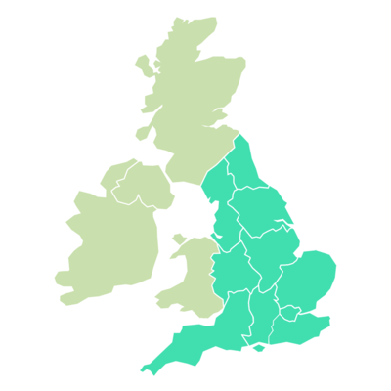
More about who can apply
Your organisation must show that
activities will be good for culture and creativity in England
activities reach as many people as possible
You can only apply for this funding if you have an address in England.
If you get money from other funding programmes then you can’t apply for the funding.
These are
Capital Investment Programme - Round 1
Museum Estate and Development
Fund (MEND) – Rounds 1 and 2
Cultural Development Fund (CDF) – Rounds 1, 2 and 3
Libraries Improvement Fund (LIF) – Rounds 1 and 2

Slide 5
More about who can apply and important dates
If you haven’t got your final payment by 3 July 2023 then you can’t apply either.
This means a payment from
Small Capital Grants
Large Capital Grants
Local authorities who get grants from these programmes can apply but only if the money is for things like building work.
You must open a Grantium account and profile on your website.
We will need to say your profile is OK before you can start your application.
This takes about 10 working days.
So it’s a good idea to open your account in advance before you apply.
If you already have an account then make sure your details are all correct and up to date.

Slide 6
Making your application
We will open an Expression of Interest form in Grantium on
6 June 2023
This will close on
3 July 2023
An expression of interest is a short form that says you are interested in applying for the funding.
The full application opens on
25 July 2023
This will close on
3 October 2023
You can apply for an amount of money between
£100,000 and £750,000
We don’t give out the large amount of money to many places.

Slide 7
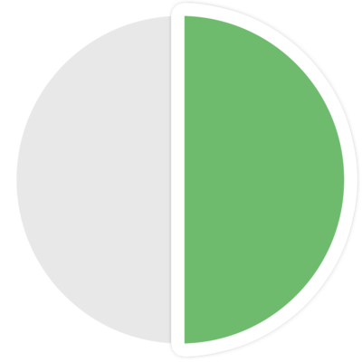
Partnership funding and other information
We need to make sure our money funds as many places as possible. So we will want you to apply for other funding money too.
This will be a different percentage depending on the size of grant you apply for.
For example, if you apply for between
£100,000 and £249,999 then at least 5% should come from somewhere else.
You might also get in kind support. This is support that isn’t money. No more than 50% of in kind support should come from a partner.
We don’t include other grants from Arts Council England or other cultural funding from the government.
You must start your activities by 31 March 2025 and end no later than 31 March 2027.
We will let everyone know if they get funding by early April 2024.

