Slide 1
Capital Investment Programme Round Two WE’RE STARTING SOON…
We recommend using the Desktop version of Zoom.
This session will be supported by live captions and BSL interpretation.
This session will be recorded and available to watch online afterwards. We won’t ask you to turn on your camera or microphone at any time.
Later in the session we will open the Q&A box.
Artonik Bell Square © Vipul Sangoi
Artonik Bell Square © Vipul Sangoi
artscouncil.org.uk/Capital

Slide 2
Who is here today
BSL interpretation: Bibi Dalacey-Mould
Frances Everingham
Live captions: Stage Text
Presenters and panel: Bill Vince – Senior Relationship Manager, North
Edward de Souza – Director, Investment Operations and Resources
Kelly Hutchings – Senior Officer, Capital Funding
Mohammed Inham – Solicitor
Moragh Brooksbank – Senior Officer, Capital Funding
Q&A host: Edward de Souza – Director, Investment Operations and Resources
Artonik Bell Square © Vipul Sangoi
Emergency Exit Arts - Thamesmead 50th Birthday © Emergency Exit Arts
artscouncil.org.uk/Capital

Slide 3
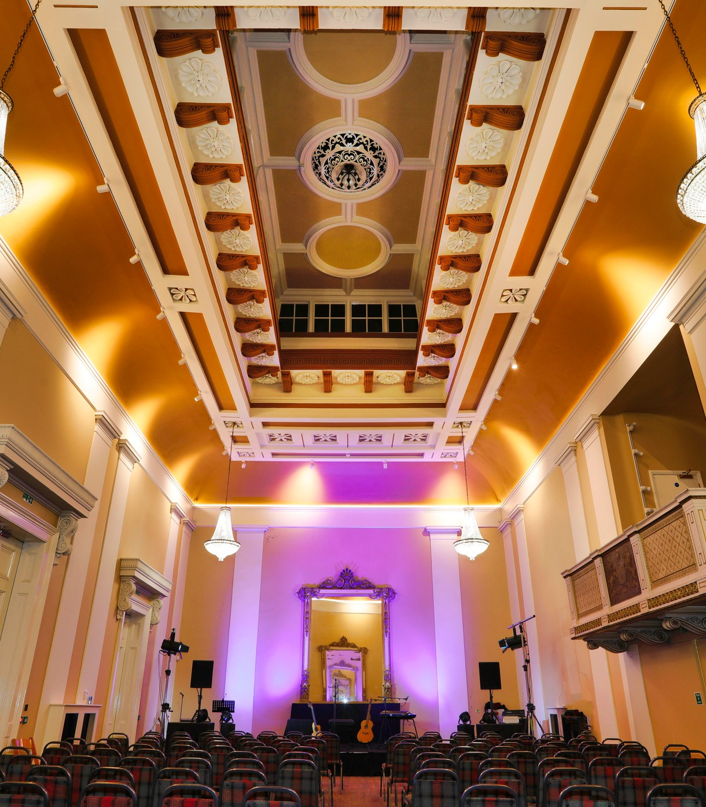
What we’ll cover today
11:05 Presentation:
Aims of the fund
Who can apply
Activity we will support
Key dates
Partnership funding
Building projects
11:30 10-minute break
Q&A box open for questions
11:40 Panel: frequently asked questions
11:55 Reminder of next steps and support available
Artonik Bell Square © Vipul Sangoi
Draper’s Hall Photo © The Prince’s Foundation
artscouncil.org.uk/Capital

Slide 4
Context and overview
This programme sits within the ‘building a fit for the future cultural sector’ theme in our Delivery Plan and runs alongside the Arts Council’s other capital strands that sit within the Cultural Investment Fund (CIF)
It supports cultural organisations to adjust buildings & equipment so that they can:
operate safely post-pandemic
improve access
seize on technological opportunities
reduce environmental impact
Budget: £20 million
Grants available: £100,000 - £750,000
Activity timescales:
start date: between 1 April 2024 and no later than 31 March 2025
end date: no later than 31 March 2027

Slide 5
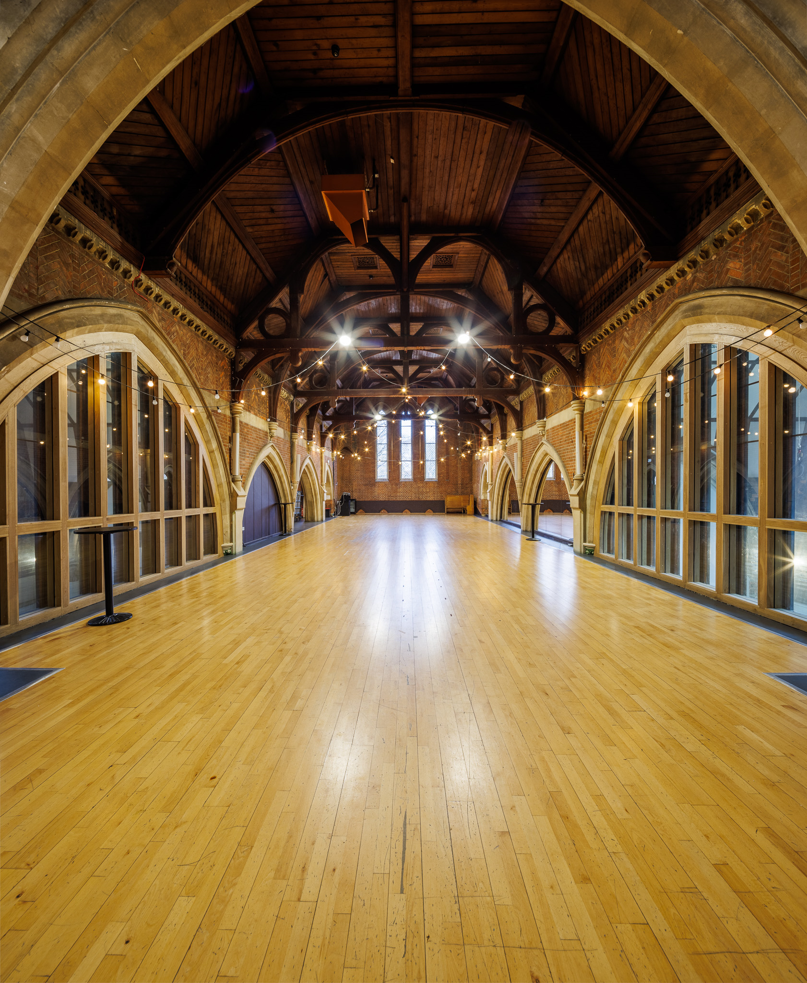
Programme aims
All communities and individuals can actively engage with and enjoy creativity and culture
Capital investments are transformational in their impact on the range and reach of collaborations related to cultural activities
Business models of cultural organisations can adapt to the changing environment around them and the needs of the communities with whom they work
Organisations exhibit dynamic behaviour, establishing new income streams to enable them to adapt to a challenging environment
Organisations demonstrate leadership in environmental responsibility
The carbon footprint of the cultural sector is reduced
Creative spaces are more inclusive, safe, and accessible for all
Jackson’s Lane. Photo © Alex Brenner
artscouncil.org.uk/Capital

Slide 6
Who can apply
Not-for-profit cultural organisations based in England – (Museums must be non-national accredited museums or formally working towards accreditation)
Partnership applications between properly constituted cultural organisations (all partners must meet programme eligibility)
Organisation’s whose primary aims are around culture
For activities that fall within the remit of Arts Council England, will benefit the cultural sector within England and are relevant to the widest possible number of people.
Who cannot apply
Organisations in receipt of a capital grant from CIP, MEND, CDF and LIF
Organisations that still have an open Small or Large Capital Grants on 3 October 2023
local authorities in receipt of grants from these funding programmes can apply where the application relates to capital expenditure for a different project/activity

Slide 7
Types of activity the programme will support
Two types of Capital Expenditure:
Digital Infrastructure
Physical Infrastructure
We define capital expenditure as an amount spent to purchase or improve fixed assets that will be capitalised on your balance sheet.
Litre of Light, Mick Stephenson, Lumiere London 2016, produced by Artichoke
Almeida – This Isn’t (A True Story) © Ali Wright
Shobana Jeyasingh – Seniors Workshop © Jason Thompson
artscouncil.org.uk/Capital

Slide 8
Partnership Funding
Grants from £100,000 to £249,999: at least 5% of the total project costs must come from other sources
Grants from £250,000 to £499,999: at least 10% of the total project costs must come from other sources
Grants from £500,000 to £750,000: at least 15% of the total project costs must come from other sources
We won’t accept grants awarded by Arts Council England as partnership funding. This includes (but is not limited to):
Cultural Investment Fund (MEND, LIF or CDF)
Culture Recovery Fund
Culture Capital Kickstart Fund

Slide 9
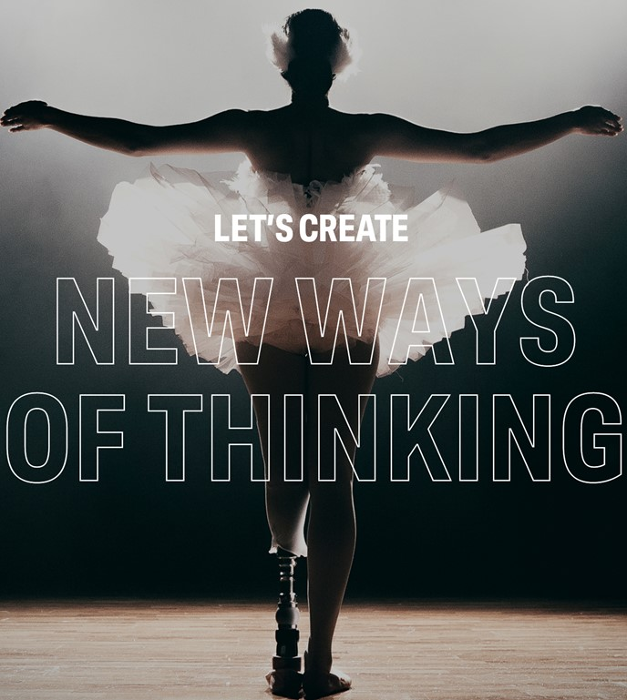
Two-stage process
1) Stage One - Expression of Interest
Complete the eligibility quiz
Select the Let’s Create Outcomes that apply
Complete an Expression of Interest on Grantium
Outline your proposal in no more than 2,500 characters (around 400 words)​
Your proposal should show that your project meets the eligibility criteria and the programme aims
2) Stage Two – Application (if invited to apply)
Black Swan, recreated for the 11 Million Reasons exhibition
Commissioned by People Dancing © Sean Goldthorpe
artscouncil.org.uk/Capital

Slide 10
Application form
Proposal
Specific Questions
Attachments
Investment Principles
finance
Evaluation and Investment Priniciple impacts
access and inclusion
project beneficiaries
activity plan
project location
building project information
meeting the brief
governance & management
financial viability
mandatory (all applicants)
risk register
partnership funding
procurement method statement
cash flow

Slide 11
Timeline
Expression of Interest (EOI)
EOIs Considered
Application
Assessments
Balancing
Notifications
Deadline
3 July 2023
25 July – 3 October 2023
End March/early April 2024
© Yorkshire Festival
Almeida – This Isn’t (A True Story) © Ali Wright
#LetsCreate

Slide 12
Balancing factors
Geographical location (Priority Places) | Type of activity (physical vs. digital activity)
Diversity (organisations representative of this country in terms of protected characteristics and socio-economic background) | Risk (within overall portfolio of projects to be funded)

Slide 13
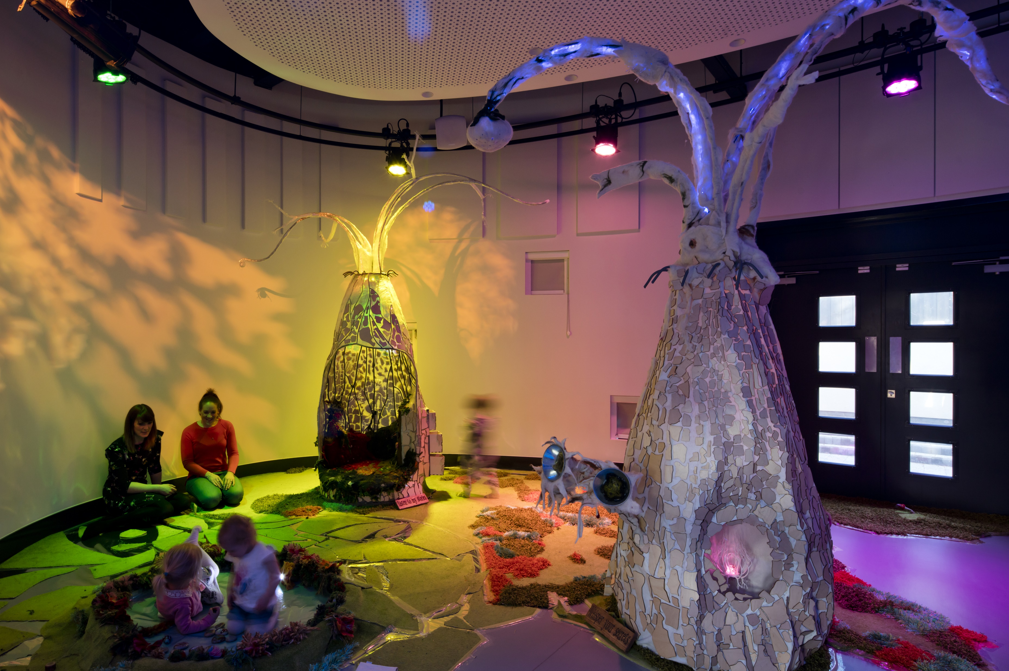
Activity timescales
Activities must start by 31 March 2025. By this date grant holders must have:
submitted to the Arts Council and had approved an initial payment request and any related payment conditions;
secured 100 per cent of the partnership funding required to complete the project;
obtained all necessary statutory approvals and consents required to start the project, where applicable; and
completed all land and lease agreements required to start the project, where applicable.
Litre of Light, Mick Stephenson, Lumiere London 2016, produced by Artichoke
Almeida – This Isn’t (A True Story) © Ali Wright
National Youth Theatre of Great Britain – Summer Courses © Alessandra Davids
artscouncil.org.uk/Capital

Slide 14
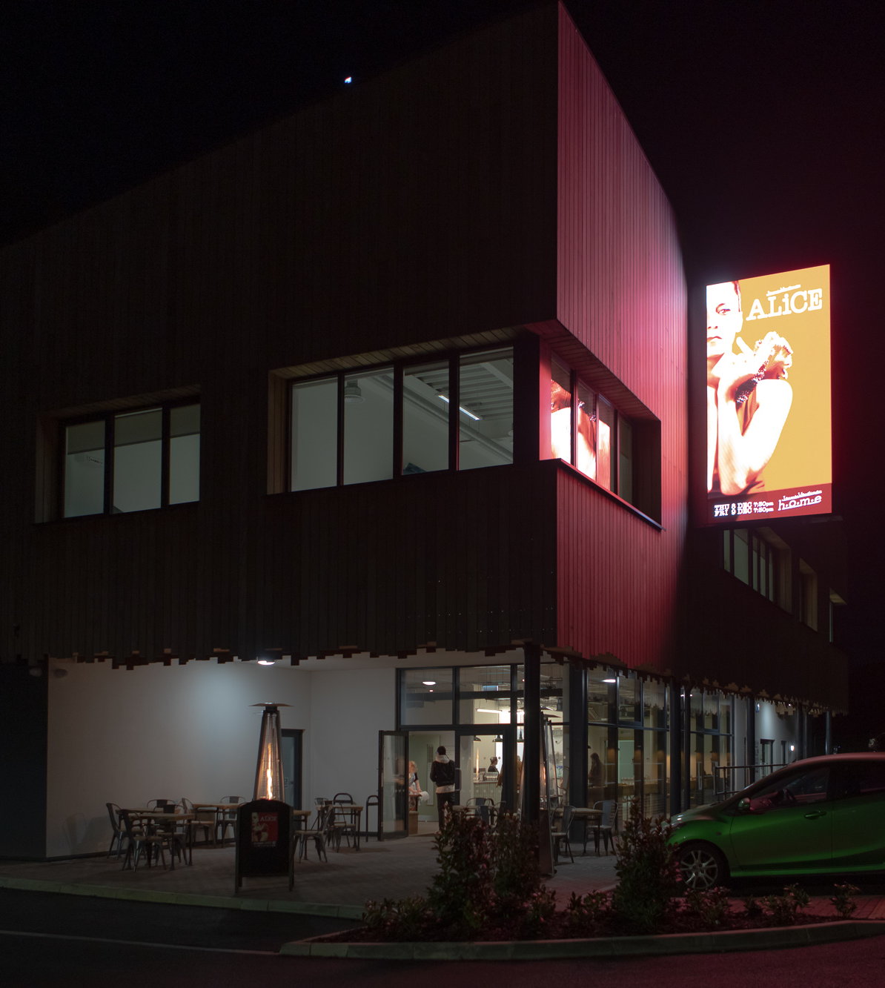
Additional eligibility criteria for building projects
At point of application (3 October 2023):
Plans developed to at least RIBA Work Stage 3 or equivalent
Have ownership of land and/or buildings (freehold or leasehold) where the project will take place
By first payment (by 31 March 2025):
Obtained all statutory approvals, planning permission and consents required to start the project
Completed all legal and lease agreements required to start the project, e.g. Deed of Variation to lease
Litre of Light, Mick Stephenson, Lumiere London 2016, produced by Artichoke
Almeida – This Isn’t (A True Story) © Ali Wright
JVC Photo © Elly Rutherford
artscouncil.org.uk/Capital

Slide 15
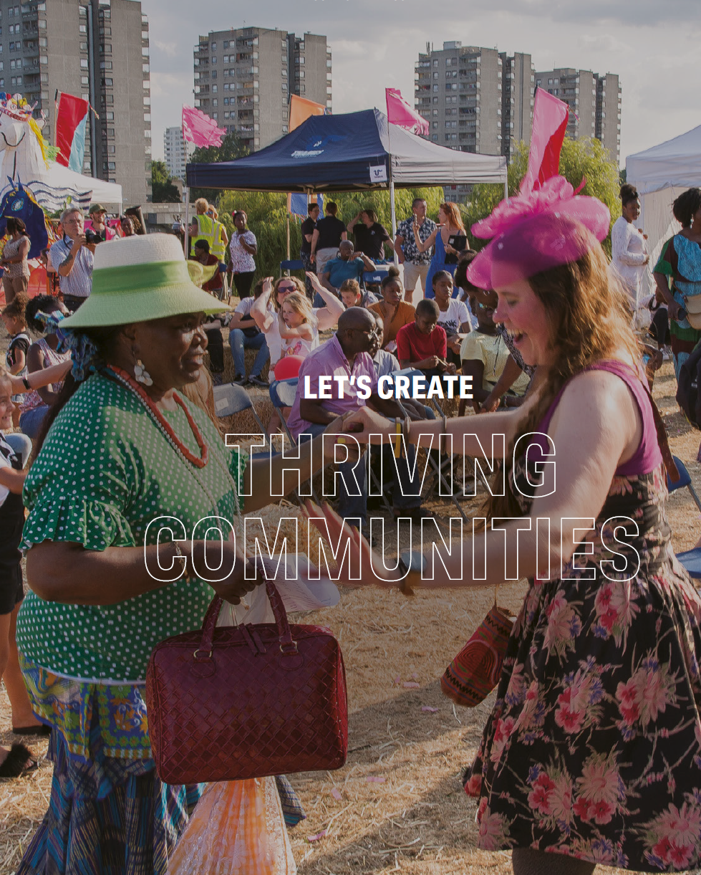
Legal and security
Applicants must own the property where the project will take place (freehold or leasehold).
Leaseholders must demonstrate:
They hold the responsibilities for repair and insurance under the lease terms (eg. a full repairing lease)
Grants from £100,000 to £499,999: a registered and assignable lease of at least 10 years
Grants from £500,000 to £750,000: a registered and assignable lease of at least 15 years
Leases should be without a break clause or a forfeiture on insolvency clause, and have a permitted user clause that is compliant with the project and the proposed use
Security on grants over £500,000 or grants to purchase land and/or buildings
15-year Deed of Covenant with a restriction on the Land Registry title
Emergency Exit Arts - Thamesmead 50th Birthday © Emergency Exit Arts
Artonik Bell Square © Vipul Sangoi
artscouncil.org.uk/Capital

Slide 16
That covers the information on the programme
Q&A box now open for questions
10 minute break
… then we’ll continue the session
Next up: panel answer some FAQs
Artonik Bell Square © Vipul Sangoi
artscouncil.org.uk/Capital

Slide 17
Questions?
Q&A box open for questions until end of session
Full guidance (available in large print and audio)
Frequently Asked Questions
https://www.artscouncil.org.uk/developing-creativity-and-culture/capital
Further questions or need access support?
Contact our Customer Services team by phone, email or webchat:
artscouncil.org.uk/our-organisation/contact-us
Hullabaloo, The Enchanged Forest - photo © Kriste McCluskie
#LetsCreate

Slide 18
Before you go…
When’s the Expression of Interest deadline? 3 July 2023
What steps should I take first? Read the guidance for applicants, register on our application portal, Grantium
Can I start my application? Application portal opens 25 July
What if I have a question? Take a look at our FAQs. If you can’t find the answer there, get in touch.
Everything you need can be found here:
https://www.artscouncil.org.uk/developing-creativity-and-culture/capital
https://www.artscouncil.org.uk/how-we-invest-public-money-0/subsidy-control/faqs-subsidy-control
https://www.artscouncil.org.uk/lets-create/strategy-2020-2030/investment-principles
Artonik Bell Square © Vipul Sangoi
artscouncil.org.uk/Capital

